Slide 1
M.S. Ramaiah Institute of Technology
(Autonomous Institute, Affiliated to VTU)
Department of CSE (AIML) and CSE (Cyber Security)
Course Name: Database Management Systems Course Code: CI32 Credits: 3:0:1 UNIT 4
Reference:
Abraham Silberschatz, Henry F Korth, S. Sudarshan
Database System Concepts (7th Edition)→Prescribed textbook as per curriculum
Abraham Silberschatz, Henry F Korth, S. Sudarshan
Database System Concepts (3rd Edition)
Abraham Silberschatz, Henry F Korth, S. Sudarshan
Database System Concepts (6th Edition)

Slide 2
Unit IV Syllabus
Database Design : Informal Guidelines for Relation Schemas
Functional Dependencies
Inference Rules
Equivalence and Minimal Cover
Normal Forms based on Primary keys
First Normal Form
General Definitions of 2nd and 3rd Normal Forms
Boyce Codd Normal Form
Properties of Relational Decomposition
Algorithms for relational database schema design
Prepared By reshma Rachel cherish, Department of CSE (ai&ml) and CSE (Cyber security)
2

Slide 3
DATABASE DESIGN: Informal Design Guidelines for Relation Schemas
Informal Design Guidelines for Relational Databases
1.1 Semantics of the Relation Attributes
1.2 Redundant Information in Tuples and Update Anomalies
1.3 Null Values in Tuples
1.4 Spurious Tuples
Prepared By reshma Rachel cherish, Department of CSE (ai&ml) and CSE (Cyber security)
3

Slide 4
DATABASE DESIGN: Informal Design Guidelines for Relation Schemas
Informal Design Guidelines for Relational Databases
1.1 Semantics of the Relation Attributes
GUIDELINE 1: Informally, each tuple in a relation should represent one entity or relationship instance. (Applies to individual relations and their attributes).
Attributes of different entities (EMPLOYEEs, DEPARTMENTs, PROJECTs) should not be mixed in the same relation
Only foreign keys should be used to refer to other entities
Entity and relationship attributes should be kept apart as much as possible.
Conclusion - Design a schema that can be explained easily relation by relation. The semantics of attributes should be easy to interpret.
Prepared By reshma Rachel cherish, Department of CSE (ai&ml) and CSE (Cyber security)
4

Slide 5
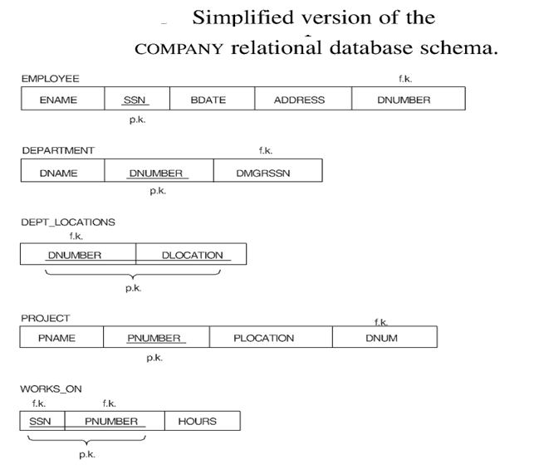
DATABASE DESIGN: Informal Design Guidelines for Relation Schemas
Informal Design Guidelines for Relational Databases
1.1 Semantics of the Relation Attributes
A simplified COMPANY relational database
schema
Prepared By reshma Rachel cherish, Department of CSE (ai&ml) and CSE (Cyber security)
5

Slide 6
DATABASE DESIGN: Informal Design Guidelines for Relation Schemas
Informal Design Guidelines for Relational Databases
1.2 Redundant Information in Tuples and Update Anomalies
Mixing attributes of multiple entities may cause problems
Information is stored redundantly wasting storage
Problems with update anomalies
Insertion anomalies
Deletion anomalies
Modification anomalies
Prepared By reshma Rachel cherish, Department of CSE (ai&ml) and CSE (Cyber security)
6

Slide 7
DATABASE DESIGN: Informal Design Guidelines for Relation Schemas
Informal Design Guidelines for Relational Databases
1.2 Redundant Information in Tuples and Update Anomalies
EXAMPLE OF AN UPDATE ANOMALY
Consider the relation: EMP_PROJ ( Emp#, Proj#, Ename, Pname, No_hours)
Update Anomaly: Changing the name of project number P1 from “Billing” to “Customer-Accounting” may cause this update to be made for all 100 employees working on project P1.
Insert Anomaly: Cannot insert a project unless an employee is assigned to the project. In other words, cannot insert an employee unless he/she is assigned to a project.
Delete Anomaly: When a project is deleted, it will result in deleting all the employees who work on that project. Alternately, if an employee is the sole employee on a project, deleting that employee would result in deleting the corresponding project.
Prepared By reshma Rachel cherish, Department of CSE (ai&ml) and CSE (Cyber security)
7

Slide 8
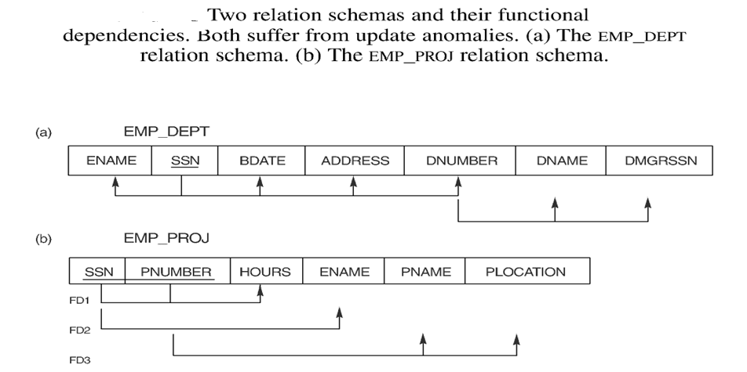
DATABASE DESIGN: Informal Design Guidelines for Relation Schemas
Informal Design Guidelines for Relational Databases
1.2 Redundant Information in Tuples and Update Anomalies
Two relation schemas suffering from update anomalies
Prepared By reshma Rachel cherish, Department of CSE (ai&ml) and CSE (Cyber security)
8

Slide 9
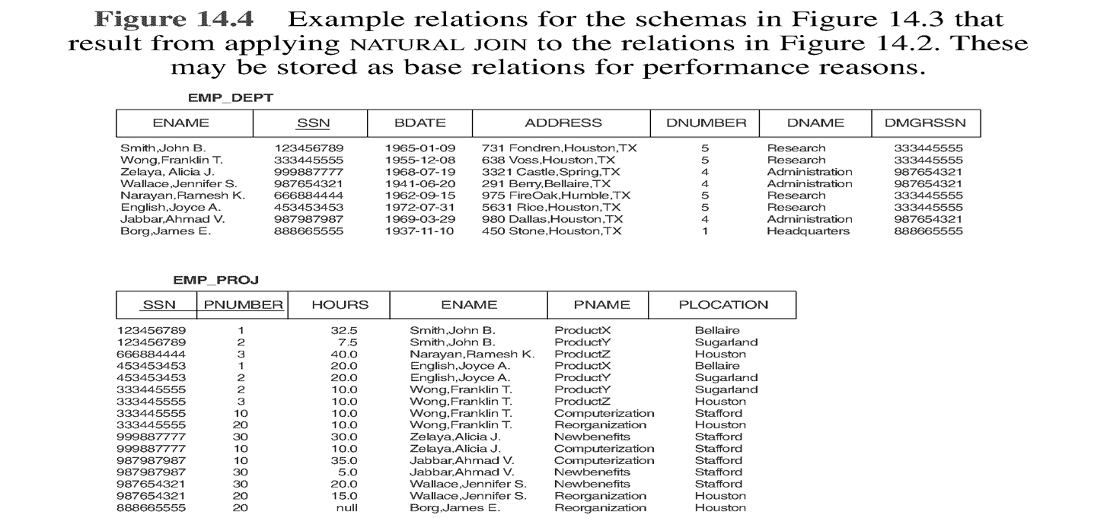
DATABASE DESIGN: Informal Design Guidelines for Relation Schemas
Informal Design Guidelines for Relational Databases
1.2 Redundant Information in Tuples and Update Anomalies
Prepared By reshma Rachel cherish, Department of CSE (ai&ml) and CSE (Cyber security)
9

Slide 10
DATABASE DESIGN: Informal Design Guidelines for Relation Schemas
Informal Design Guidelines for Relational Databases
1.2 Redundant Information in Tuples and Update Anomalies
GUIDELINE 2: Design a schema that does not suffer from the insertion, deletion and update anomalies. If there are any present, then note them so that applications can be made to take them into account
1.3 Null Values in Tuples
GUIDELINE 3: Relations should be designed such that their tuples will have as few NULL values as possible. Attributes that are NULL frequently could be placed in separate relations (with the primary key)
Reasons for nulls:
attribute not applicable or invalid
attribute value unknown (may exist)
value known to exist, but unavailable
Prepared By reshma Rachel cherish, Department of CSE (ai&ml) and CSE (Cyber security)
10

Slide 11
DATABASE DESIGN: Informal Design Guidelines for Relation Schemas
Informal Design Guidelines for Relational Databases
1.4 Spurious Tuples
Bad designs for a relational database may result in erroneous results for certain JOIN operations.
The "lossless join" property is used to guarantee meaningful results for join operations.
GUIDELINE 4: The relations should be designed to satisfy the lossless join condition. No spurious tuples should be generated by doing a natural-join of any relations.
There are two important properties of decompositions:
non-additive or losslessness of the corresponding join
preservation of the functional dependencies.
Note that
Property (a) is extremely important and cannot be sacrificed.
Property (b) is less stringent and may be sacrificed.
Prepared By reshma Rachel cherish, Department of CSE (ai&ml) and CSE (Cyber security)
11

Slide 12
DATABASE DESIGN: Informal Design Guidelines for Relation Schemas
Thus, to conclude we can derive at the following:
Problem Statement: Designing a schema for a relational database.
Goal / Target: To generate a set of relation schemas that allows us
to store information without unnecessary redundancy.
Allows us to retrieve information easily.
This goal is achieved by designing the schemas in a NORMAL FORM (a series of guidelines that help ensure a database’s design is efficient, organized, and free from data anomalies).
How do we know that a relational schema is in one of the desirable normal forms?
We compare the relational schema design for our mini world with the real-world enterprise.
We can look at the well-designed ER diagram that we had created as part of the conceptual modelling for our database.
Prepared By reshma Rachel cherish, Department of CSE (ai&ml) and CSE (Cyber security)
12

Slide 13
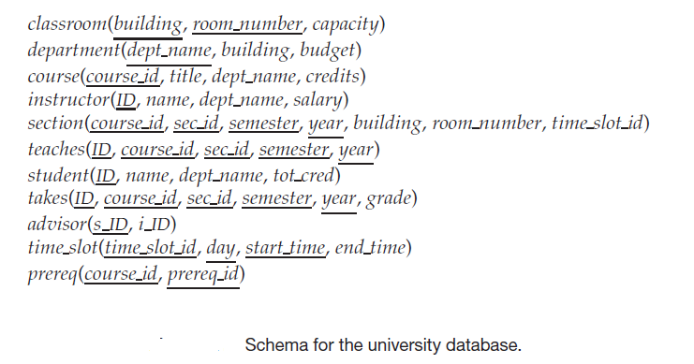
DATABASE DESIGN: Informal Design Guidelines for Relation Schemas
Now here, there is one more way to validate the relational schema designed for our miniworld in a more formal approach.
This is done by the introduction of a concept known as FUNCTIONAL DEPENDENCIES.
Assessing the desirability of a collection of relation schemas
Consider the relation schema for the University database that we had seen in previous chapters.
Prepared By reshma Rachel cherish, Department of CSE (ai&ml) and CSE (Cyber security)
13

Slide 14
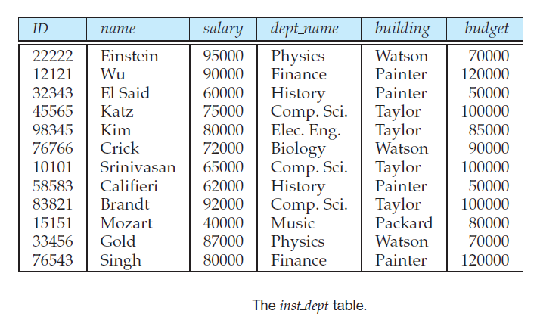
DATABASE DESIGN: Informal Design Guidelines for Relation Schemas
Design Alternative : Larger Schemas
Suppose that instead of having the schemas instructor and department, we have the schema:
This represents the result of a natural join on the relations corresponding to instructor and department.
This is the instance of the inst_dept relation
Prepared By reshma Rachel cherish, Department of CSE (ai&ml) and CSE (Cyber security)
14

Slide 15
DATABASE DESIGN: Informal Design Guidelines for Relation Schemas
Notice that we have to repeat the department information (“building” and “budget”) once for each instructor in the department.
For example, the information about the Comp. Sci. department (Taylor, 100000) is included in the tuples of instructors Katz, Srinivasan, and Brandt.
Data Inconsistency : In our original design using instructor and department, we stored the amount of each budget exactly once. This suggests that using inst_dept is a bad idea since it stores the budget amounts redundantly and runs the risk that some user might update the budget amount in one tuple but not all, and thus create inconsistency.
Updation becomes tedious: Another problem with the inst_dept schema is that suppose we are creating a new department in the university. In the alternative design above, we cannot directly represent the information concerning a department (dept name, building, budget) unless that department has at least one instructor at the university. This is because tuples in the inst_dept table require values for ID, name, and salary. This means that we cannot record information about the newly created department until the first instructor is hired for the new department. So, in the old design (slide 4), the relation department can handle this scenario. As per the revised design, the only solution is to create a tuple with a NULL value for building and budget.
Prepared By reshma Rachel cherish, Department of CSE (ai&ml) and CSE (Cyber security)
15

Slide 16
DATABASE DESIGN: Informal Design Guidelines for Relation Schemas
2. Design Alternative : Smaller Schemas
DECOMPOSITION
For example, we consider the schema of inst_dept.
The question here is
when and how we can decide on splitting the relation into the schemas instructor and department?
The end goal here is
To avoid the repetition-of-information problem in the inst_dept relation
How can splitting the relation or decomposition/decomposing of the two schemas(instructor and department) be done.
As a general rule of thumb,
A SCHEMA THAT EXHIBITS REPETITION OF INFORMATION MAY HAVE TO BE DECOMPOSED INTO SEVERAL SMALLER SCHEMAS.
Prepared By reshma Rachel cherish, Department of CSE (ai&ml) and CSE (Cyber security)
16

Slide 17
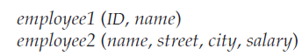
DATABASE DESIGN: Informal Design Guidelines for Relation Schemas
2. Design Alternative : Smaller Schemas
DECOMPOSITION
When does decomposition of schemas not helpful?
Consider the case in which all schemas consist of only one attribute – no meaningful relationships can be formed after decomposition.
Consider another case in which we wish to decompose the employee schema below into the following schemas:
Prepared By reshma Rachel cherish, Department of CSE (ai&ml) and CSE (Cyber security)
17

Slide 18
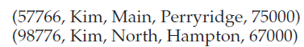
DATABASE DESIGN: Informal Design Guidelines for Relation Schemas
2. Design Alternative : Smaller Schemas
DECOMPOSITION
When will this decomposition be a flaw or challenge?
When the enterprise or real-world has 2 employees with the same name. (This scenario is not unlikely in the real-world)
Now here, as per the schema, each person has a unique employee-id and this ID can serve as a primary key.
Example, let’s assume two employees, both named Kim, work at the university and have the following tuples in the relation on schema employee in the original design:
Prepared By reshma Rachel cherish, Department of CSE (ai&ml) and CSE (Cyber security)
18

Slide 19
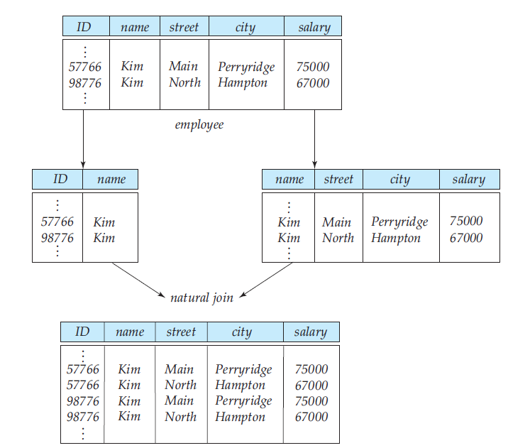
DATABASE DESIGN: Informal Design Guidelines for Relation Schemas
2. Design Alternative : Smaller Schemas
DECOMPOSITION
The first level and second level of tables shows tuples using the schemas resulting from the decomposition.
The last table shows the result ,if we attempted to regenerate the original tuples using a natural join.
Here we see that the two original tuples appear in the result along with two new tuples that incorrectly mix data values of the two employees named Kim.
This indicates that though there are more tuples but we are having less information that makes sense.
Thus, the decomposition is unable to represent certain important facts about the university employees. Such decompositions that result in loss of valuable information or which causes ambiguity in the data is referred to as a LOSSY DECOMPOSITION and those that are not causing so are known as LOSSLESS DECOMPOSITIONS.
Prepared By reshma Rachel cherish, Department of CSE (ai&ml) and CSE (Cyber security)
19

Slide 20
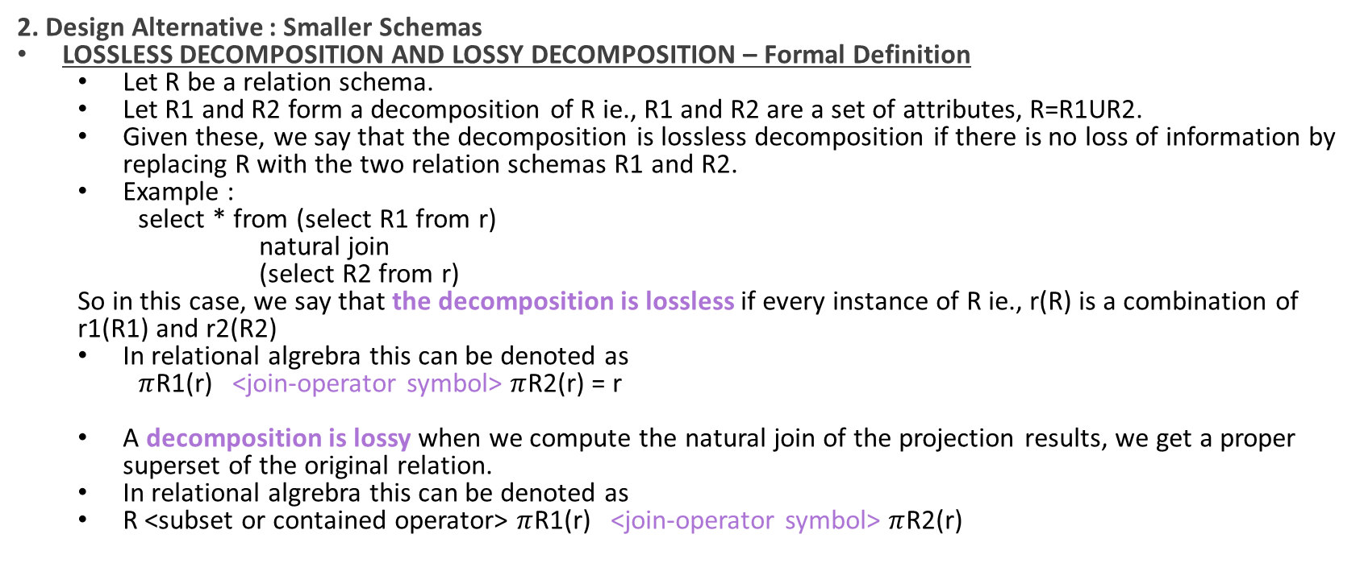
DATABASE DESIGN: Informal Design Guidelines for Relation Schemas
2. Design Alternative : Smaller Schemas
LOSSLESS DECOMPOSITION AND LOSSY DECOMPOSITION – Formal Definition
Let R be a relation schema.
Let R1 and R2 form a decomposition of R ie., R1 and R2 are a set of attributes, R=R1UR2.
Given these, we say that the decomposition is lossless decomposition if there is no loss of information by replacing R with the two relation schemas R1 and R2.
Example :
select * from (select R1 from r)
natural join
(select R2 from r)
So in this case, we say that the decomposition is lossless if every instance of R ie., r(R) is a combination of r1(R1) and r2(R2)
In relational algrebra this can be denoted as
$π$R1(r) <join-operator symbol> $π$R2(r) = r
A decomposition is lossy when we compute the natural join of the projection results, we get a proper superset of the original relation.
In relational algrebra this can be denoted as
R <subset or contained operator> $π$R1(r) <join-operator symbol> $π$R2(r)
Prepared By reshma Rachel cherish, Department of CSE (ai&ml) and CSE (Cyber security)
20

Slide 21
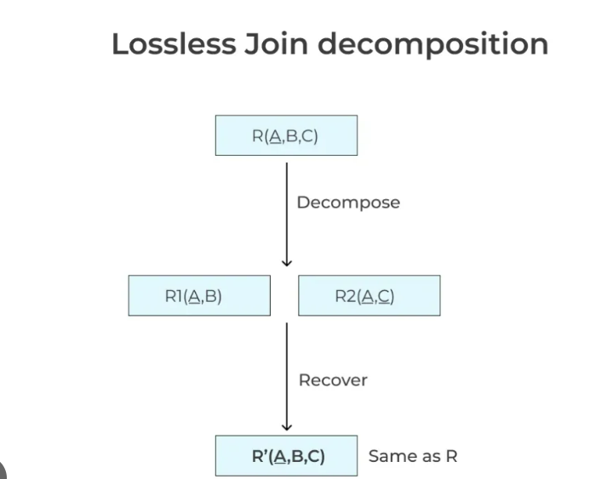
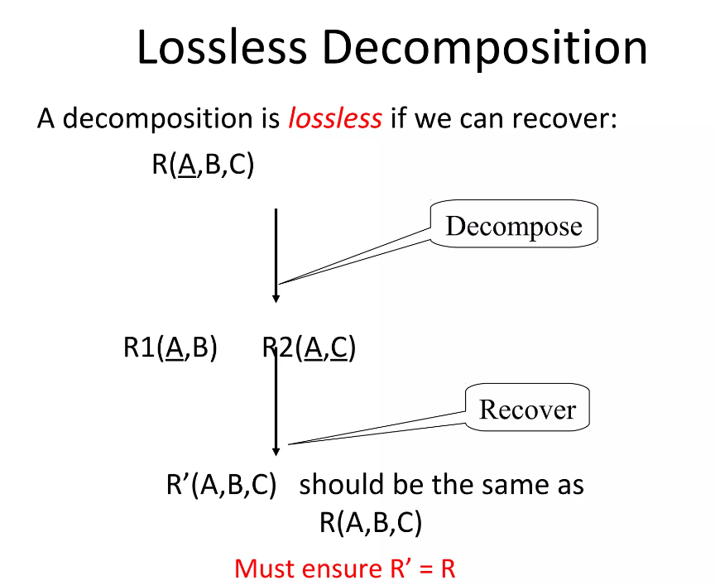
DATABASE DESIGN: Informal Design Guidelines for Relation Schemas
2. Design Alternative : Smaller Schemas
LOSSLESS DECOMPOSITION - Concept
Prepared By reshma Rachel cherish, Department of CSE (ai&ml) and CSE (Cyber security)
21

Slide 22
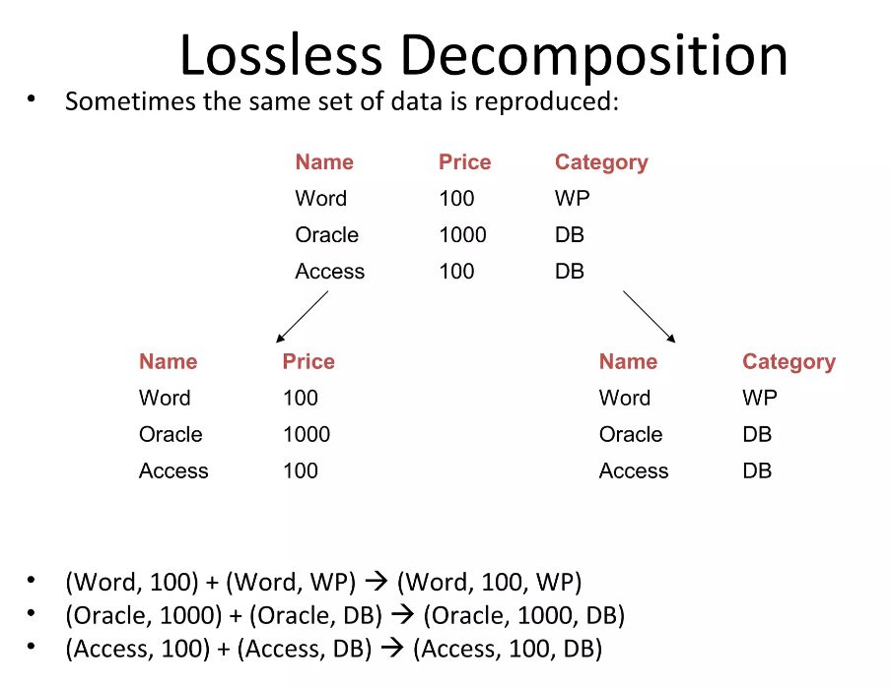
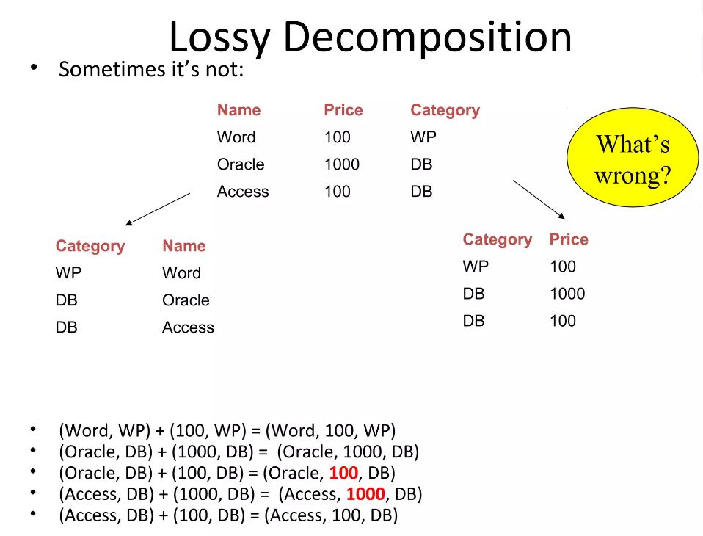
DATABASE DESIGN: Informal Design Guidelines for Relation Schemas
2. Design Alternative : Smaller Schemas
LOSSLESS DECOMPOSITION AND LOSSY DECOMPOSITION - Examples
Prepared By reshma Rachel cherish, Department of CSE (ai&ml) and CSE (Cyber security)
22

Slide 23
NORMALIZATION THEORY
NORMALIZATION THEORY
Goal - A general methodology for deriving a set of schemas each of which is in “good form”; that is, does not suffer from the repetition-of-information problem.
The method for designing a relational database is to use a process commonly known as normalization.
Approach for normalization –
Decide if a given relation schema is in “good form.”
How? - There are a number of different forms (called normal forms) – 1NF-First Normal Form,2NF-Second Normal Form,3NF-Third Normal Form, and Boyce Codd Normal Form
If a given relation schema is not in “good form,” then we
decompose it into a number of smaller relation schemas,
each of the relation schemas should be in an appropriate normal form.
Check and ensure that the decomposition is a lossless decomposition.
Prepared By reshma Rachel cherish, Department of CSE (ai&ml) and CSE (Cyber security)
23

Slide 24
FUNCTIONAL DEPENDENCIES
FUNCTIONAL DEPENDENCIES
A database models a set of entities and relationships in the real world.
There are usually a variety of constraints (rules) on the data in the real world.
Example – In a university database,
Students and instructors are uniquely identified by their ID.
Each student and instructor has only one name.
Each instructor and student is (primarily) associated with only one department
Each instructor and student is (primarily) associated with only one department
Each department has only one value for its budget, and only one associated building.
What is LEGAL INSTANCE OF THE RELATION?
An instance of a relation that satisfies all real-world constraints.
What is LEGAL INSTANCE OF THE DATABASE?
All the relation instances are legal instances.
Prepared By reshma Rachel cherish, Department of CSE (ai&ml) and CSE (Cyber security)
24

Slide 25
FUNCTIONAL DEPENDENCIES
NOTATIONAL CONVENTIONS – For a relational database design,
Terms | Notations
Set of Attributes | Greek letters (Eg., α)
Relation Schema | Upper case roman letters (Eg., I, V, X, L, )
Refers to a relation r with the schema R | r(R ) - refers both to the relation and its schema
A set of attributes is a superkey | K Eg., K is a superkey for R
Lowercase names for relations. But in algorithms or formal definitions we use single letters like ‘r’ | Eg., instructors, students
Instance of ‘r’ - a particular value at any given time | Use the relation name ‘r’
Prepared By reshma Rachel cherish, Department of CSE (ai&ml) and CSE (Cyber security)
25

Slide 26
FUNCTIONAL DEPENDENCIES
KEYS AND FUNCTIONAL DEPENDENCIES
The most commonly used types of real-world constraints can be represented formally as keys or as functional dependencies.
Super keys – set of one or more attributes that, taken collectively, allows us to identify uniquely a tuple in the relation
Candidate keys – a minimal super key, meaning it's a super key that doesn't include any redundant attributes
Primary Keys - uniquely identify and index each row within a single table.
Functional Dependency (FD)
A functional dependency is a constraint that describes a relationship between two sets of attributes in a relation (or table).
A set of attributes X functionally determines a set of attributes Y if the value of X determines a unique value for Y
X -> Y holds if, whenever two tuples have the same value for the attributes in X, they must have the same value for Y
Prepared By reshma Rachel cherish, Department of CSE (ai&ml) and CSE (Cyber security)
26

Slide 27
FUNCTIONAL DEPENDENCIES
KEYS AND FUNCTIONAL DEPENDENCIES
Functional Dependency (FD)
For any two tuples t1 and t2 in any relation instance r(R): If t1[X]=t2[X], then t1[Y]=t2[Y]
X -> Y in R specifies a constraint on all relation instances r(R)
Written as X -> Y; can be displayed graphically on a relation schema as
Examples of Functional Dependencies
social security number determines employee name SSN -> ENAME
project number determines project name and location PNUMBER -> {PNAME, PLOCATION}
Employee ssn and project number determine the hours per week that the employee works on the project {SSN, PNUMBER} -> HOURS
Suppose consider the example of the schema that we considered earlier
Here the functional dependency dept_name → budget holds because for each department
(identified by dept_name) there is a unique budget amount.
Prepared By reshma Rachel cherish, Department of CSE (ai&ml) and CSE (Cyber security)
27

Slide 28
FUNCTIONAL DEPENDENCIES
KEYS AND FUNCTIONAL DEPENDENCIES
the pair of attributes (ID, dept name) forms a superkey for in_dep and we can write it as
Usage of Functional Dependencies
To test instances of relations to see whether they satisfy a given set F of functional
Dependencies.
2. To specify constraints on the set of legal relations. When a constraint is specified for relations on schema r(R), then it should be such that the constraint satisfies a set F of functional dependencies, then we can say that F holds on r(R).
Prepared By reshma Rachel cherish, Department of CSE (ai&ml) and CSE (Cyber security)
28

Slide 29
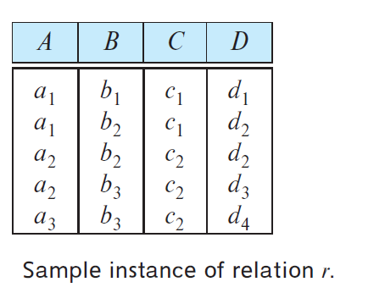
FUNCTIONAL DEPENDENCIES
KEYS AND FUNCTIONAL DEPENDENCIES
Consider the instance of relation r to see which functional dependencies
are satisfied.
Here, A → C is satisfied.
Reason: There are two tuples that have an A value of a1.
These tuples have the same C value—namely, c1.
Similarly, the two tuples with an A value of a2 have the
same C value, c2.
2. Here, C → A is not satisfied.
Reason: Consider the tuples t1 = (a2, b3, c2, d3) and t2 =(a3, b3, c2, d4)
These two tuples have the same C values, c2, but they have different A values, a2 and a3, respectively.
Thus, we have found a pair of tuples t1 and t2 such that t1[C] = t2[C], but t1[A] ≠ t2[A].
Thus in this case the functional dependency FD is said to be non-trivial.
However, certain functional dependencies are said to be trivial because they are satisfied by all
relations.
Prepared By reshma Rachel cherish, Department of CSE (ai&ml) and CSE (Cyber security)
29

Slide 30
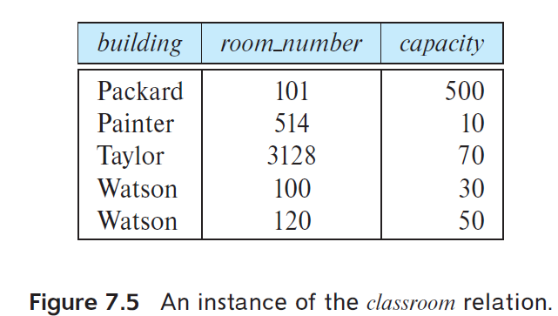
FUNCTIONAL DEPENDENCIES
KEYS AND FUNCTIONAL DEPENDENCIES
Consider the instance of relation classroom to see which functional dependencies are satisfied.
Here, room_number → capacity is satisfied.
2. In the real world, two classrooms in different buildings can
have the same room number but with different room capacity. Thus, it is possible, at
some time, to have an instance of the classroom relation in which room number →
capacity is not satisfied.
Prepared By reshma Rachel cherish, Department of CSE (ai&ml) and CSE (Cyber security)
30

Slide 31
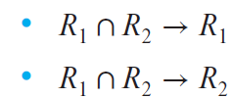
FUNCTIONAL DEPENDENCIES
KEYS AND FUNCTIONAL DEPENDENCIES
Hence,
Given a schema r(A, B, C), if functional dependencies A → B and B → C hold on r,
we can infer the functional dependency A → C must also hold on r.
Closure: the set of all functional dependencies that can be inferred given the set F. notation F⁺ to denote the closure of the set F. F+ contains all of the functional dependencies in F.
LOSSLESS DECOMPOSITION AND FUNCTIONAL DEPENDENCIES
Purpose: To show that certain decompositions are lossless we can use functional dependencies.
Consider R = a relation schema
R1, R2 = decompositions of R
F = Given set of FD in R
R1 and R2 form a lossless decomposition of R if and only if atleast one of the functional dependencies is in F⁺
Prepared By reshma Rachel cherish, Department of CSE (ai&ml) and CSE (Cyber security)
31

Slide 32
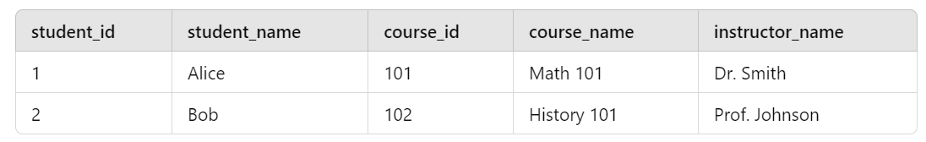
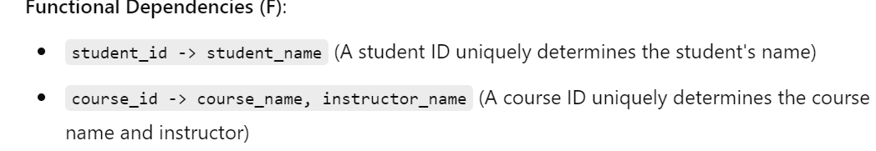
FUNCTIONAL DEPENDENCIES
LOSSLESS DECOMPOSITION AND FUNCTIONAL DEPENDENCIES
If R1∩R2 forms a superkey for either R1 or R2, the decomposition of R is a lossless decomposition.
Example consider the student table
Prepared By reshma Rachel cherish, Department of CSE (ai&ml) and CSE (Cyber security)
32

Slide 33
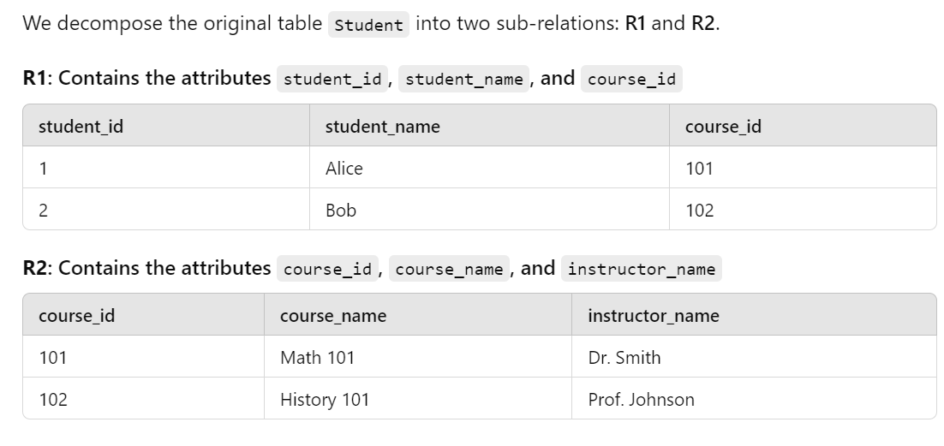
FUNCTIONAL DEPENDENCIES
LOSSLESS DECOMPOSITION AND FUNCTIONAL DEPENDENCIES
Prepared By reshma Rachel cherish, Department of CSE (ai&ml) and CSE (Cyber security)
33

Slide 34
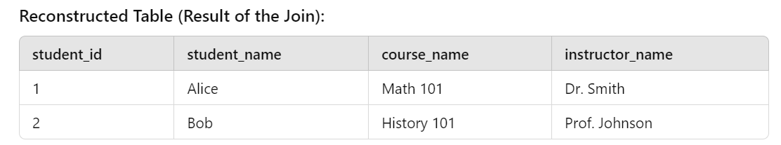
FUNCTIONAL DEPENDENCIES
LOSSLESS DECOMPOSITION AND FUNCTIONAL DEPENDENCIES
This decomposition is lossless because:
R1 and R2 share the common attribute course_id.
The functional dependency course_id -> course_name, instructor_name ensures that the data in R2 can be fully reconstructed when we join it with R1.
The original data can be perfectly reconstructed from R1 and R2, ensuring no information is lost.
Prepared By reshma Rachel cherish, Department of CSE (ai&ml) and CSE (Cyber security)
34

Slide 35
FUNCTIONAL DEPENDENCIES
LOSSLESS DECOMPOSITION AND FUNCTIONAL DEPENDENCIES
After decomposition, how to ensure that the contents are consistent with the original schema?
Suppose we decompose a relation schema r(R) into r1(R1) and r2(R2), where R1 ∩ R2 → R1.
Then the following SQL constraints must be imposed on the decomposed schema to ensure their contents are consistent with the original schema.
R1 ∩ R2 is the primary key of r1. This constraint enforces the functional dependency.
R1 ∩ R2 is a foreign key from r2 referencing r1. This constraint ensures that each tuple in r2 has a matching tuple in r1, without which it would not appear in the natural join of r1 and r2.
Prepared By reshma Rachel cherish, Department of CSE (ai&ml) and CSE (Cyber security)
35

Slide 36
FUNCTIONAL DEPENDENCIES
1.1 Closure Set of Functional Dependencies
1.1.1 Inference Rules
1.1.1 Closure of Attribute Sets
1.2 Equivalence and Minimal Cover – Canonical Cover
Prepared By reshma Rachel cherish, Department of CSE (ai&ml) and CSE (Cyber security)
36

Slide 37
FUNCTIONAL DEPENDENCIES
Closure Set of Functional Dependencies
Given a set F of functional dependencies on a schema, we can prove that certain other functional dependencies also hold on the schema.
Such additional functional dependencies are “logically implied” by F.
When testing for normal forms, it is not sufficient to consider the given set of functional dependencies; rather, we need to consider all functional dependencies that hold on the schema.
Formally,
Given relation schema r(R),
a functional dependency f on R is logically implied by a set of functional dependencies
F on R,
if every instance of a relation r(R) that satisfies F also satisfies f .
Prepared By reshma Rachel cherish, Department of CSE (ai&ml) and CSE (Cyber security)
37

Slide 38
FUNCTIONAL DEPENDENCIES
Closure Set of Functional Dependencies
Consider the scenario below:
Given:
relation schema r(A, B, C, G, H, I ) and
the set of functional dependencies:
A → B
A → C
CG → H
CG → I
B → H
To prove that there is an implied functional dependency:
A → H (Meaning: we need to prove that whenever a relation instance satisfies our given set of functional dependencies, A→H must also be satisfied by that relation Instance)
Prepared By reshma Rachel cherish, Department of CSE (ai&ml) and CSE (Cyber security)
38

Slide 39
FUNCTIONAL DEPENDENCIES
Closure Set of Functional Dependencies
Proof:
Suppose that t1 and t2 are tuples such that
t1[A] = t2[A]
Now since, we are given that A → B, it follows from the definition of functional dependency that:
t1[B] = t2[B]
Then, since we are given that B → H, it follows from the definition of functional dependency that:
t1[H] = t2[H]
Conclusion:
Hence, whenever t1 and t2 are tuples such that t1[A] = t2[A],
Thus the definition of A → H is proved.
Prepared By reshma Rachel cherish, Department of CSE (ai&ml) and CSE (Cyber security)
39

Slide 40
FUNCTIONAL DEPENDENCIES
Closure Set of Functional Dependencies
Challenges in computing the closure set F⁺ for a set of Functional Dependency F
Given F be a set of functional dependencies, the closure of F, denoted by F+, is the set of all functional dependencies logically implied by F.
Given F we can compute F⁺ directly from the formal definition of functional dependency.
Now imagine a scenario where F is large, the computation process for F⁺ would be lengthy and difficult.
AXIOMS
Rules of Inference or Axioms provide a simpler technique for reasoning about functional dependencies.
Here the following notations are used:
Greek letters (α, β, γ,…) for sets of attributes
uppercase Roman letters from the beginning of the alphabet for individual attributes
αβ denotes denote α ∪ β
Prepared By reshma Rachel cherish, Department of CSE (ai&ml) and CSE (Cyber security)
40

Slide 41
FUNCTIONAL DEPENDENCIES
Closure Set of Functional Dependencies
The Rules of Inference or Axioms can be used to find logically implied functional dependencies.
By applying these rules repeatedly, we can find all of F+, given F.
This collection of rules is called ARMSTRONG’S AXIOMS.
The collection of rules in the Armstrong’s axioms are:
Reflexivity rule - If α is a set of attributes and β ⊆ α, then α → β holds.
Augmentation rule - α → β holds and γ is a set of attributes, then γα → γβ holds.
Transitivity rule - If α → β holds and β → γ holds, then α → γ holds.
Prepared By reshma Rachel cherish, Department of CSE (ai&ml) and CSE (Cyber security)
41

Slide 42

FUNCTIONAL DEPENDENCIES
Closure Set of Functional Dependencies
Reflexivity rule - If α is a set of attributes and β ⊆ α, then α → β holds.
Example, consider the EMPLOYEE table
So when the rule of reflexivity is applied onto this table,
Prepared By reshma Rachel cherish, Department of CSE (ai&ml) and CSE (Cyber security)
42

Slide 43
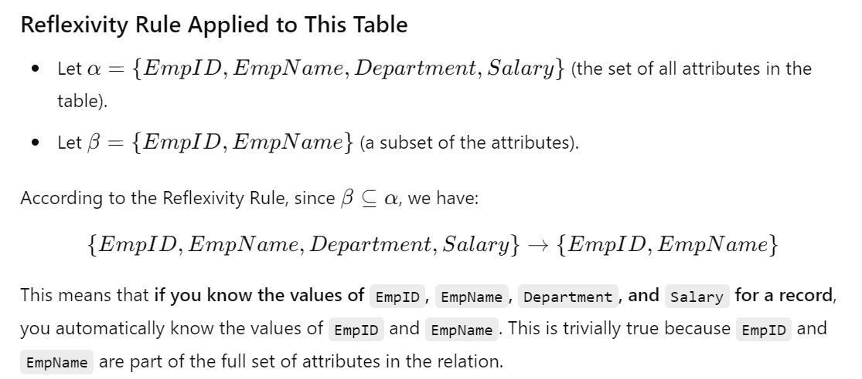
FUNCTIONAL DEPENDENCIES
Closure Set of Functional Dependencies
Prepared By reshma Rachel cherish, Department of CSE (ai&ml) and CSE (Cyber security)
43

Slide 44
FUNCTIONAL DEPENDENCIES
Closure Set of Functional Dependencies
Reflexivity rule conclusion:
The Reflexivity Rule states that for any set of attributes α and any subset β⊆α, the functional dependency α→β always holds.
In a relational table, this means that knowing all attributes in α allows you to determine any subset β, because a set of attributes always determines its own subsets.
Prepared By reshma Rachel cherish, Department of CSE (ai&ml) and CSE (Cyber security)
44

Slide 45

FUNCTIONAL DEPENDENCIES
Closure Set of Functional Dependencies
Augmentation rule - α → β holds and γ is a set of attributes, then γα → γβ holds.
Example, consider the EMPLOYEE table
So when the rule of augmentation is applied onto this table,
Prepared By reshma Rachel cherish, Department of CSE (ai&ml) and CSE (Cyber security)
45

Slide 46
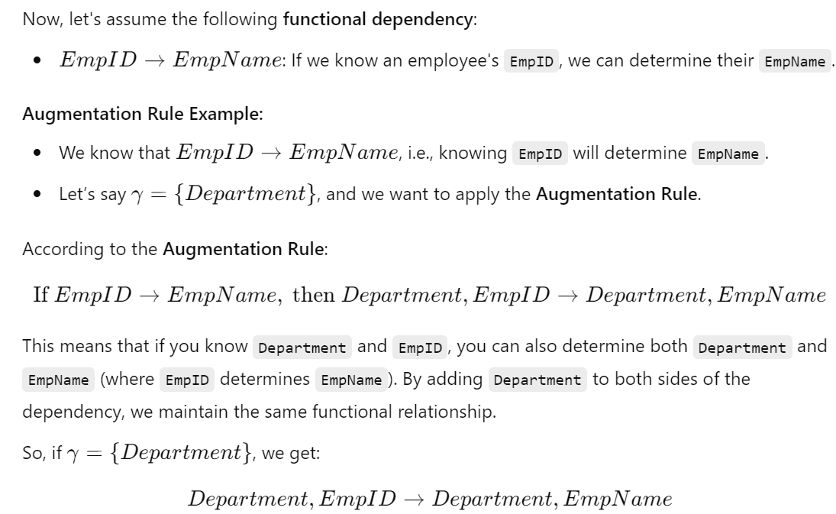
FUNCTIONAL DEPENDENCIES
Closure Set of Functional Dependencies
Prepared By reshma Rachel cherish, Department of CSE (ai&ml) and CSE (Cyber security)
46

Slide 47
FUNCTIONAL DEPENDENCIES
Closure Set of Functional Dependencies
Augmentation rule conclusion:
The Augmentation Rule says that if α→β is a valid functional dependency, then adding the same set of attributes γ to both sides of the dependency will still result in a valid functional dependency. Specifically, if α→β, then γα→γβ will also hold.
In a relational table, if we know α determines β, then adding any extra information (attributes) to both α and β still maintains the functional dependency relationship.
Prepared By reshma Rachel cherish, Department of CSE (ai&ml) and CSE (Cyber security)
47

Slide 48
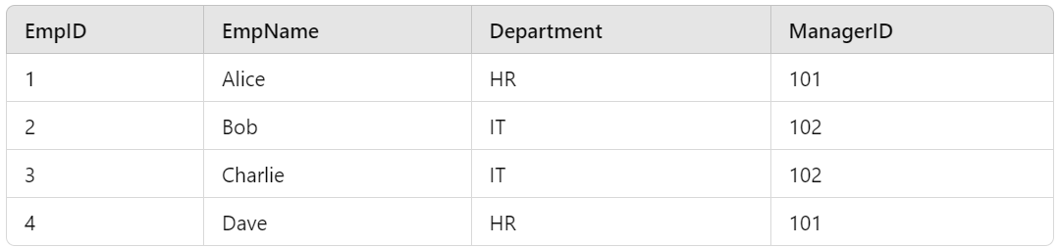
FUNCTIONAL DEPENDENCIES
Closure Set of Functional Dependencies
Transitivity rule - If α → β holds and β → γ holds, then α → γ holds.
Example, consider the EMPLOYEE table
So when the rule of transitivity is applied onto this table,
Prepared By reshma Rachel cherish, Department of CSE (ai&ml) and CSE (Cyber security)
48

Slide 49
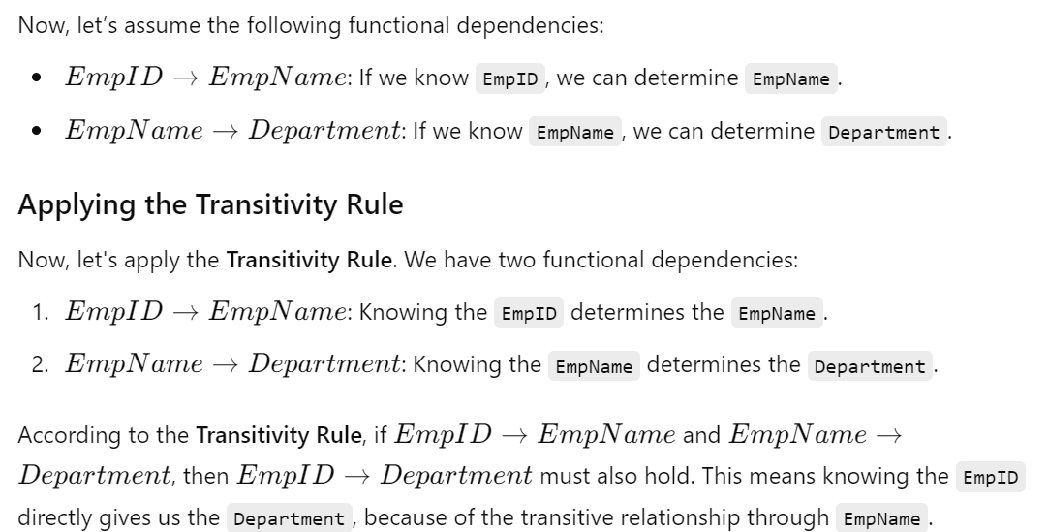
FUNCTIONAL DEPENDENCIES
Closure Set of Functional Dependencies
Prepared By reshma Rachel cherish, Department of CSE (ai&ml) and CSE (Cyber security)
49

Slide 50
FUNCTIONAL DEPENDENCIES
Closure Set of Functional Dependencies
Transitivity rule conclusion:
The Transitivity Rule states that if α→β and β→γ, then α→γ holds.
This rule allows us to derive new functional dependencies by combining existing ones.
In relational database design, the Transitivity Rule helps in simplifying the functional dependencies and reasoning about normalization.
Properties of Armstrong’s axiom:
Armstrong’s axioms are sound, because they do not generate any incorrect functional dependencies.
Armstrong’s axioms are complete, because or a given set F of functional dependencies, they allow us to generate all F⁺
Prepared By reshma Rachel cherish, Department of CSE (ai&ml) and CSE (Cyber security)
50

Slide 51
FUNCTIONAL DEPENDENCIES
Despite the Armstrong’s rule being sound and complete, it is tiresome to use them directly for the computation of F+. To simplify this, we have additional 3 rules,
4. Union rule – If α→β holds and α→ γ holds, then α →βγ holds.
5. Decompostion rule – If α→βγ holds and α→β holds and α →γ holds.
6. Pseudotransitivity rule – If α→β holds and γβ →δ holds, then αγ → δ holds.
Prepared By reshma Rachel cherish, Department of CSE (ai&ml) and CSE (Cyber security)
51

Slide 52
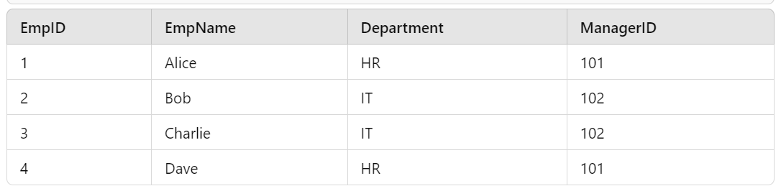
FUNCTIONAL DEPENDENCIES
Despite the Armstrong’s rule being sound and complete, it is tiresome to use them directly for the computation of F+. To simplify this, we have additional 3 rules,
4. Union rule – If α→β holds and α→ γ holds, then α →βγ holds.
i.e., α →β U γ holds.
Example, consider the EMPLOYEE table
Prepared By reshma Rachel cherish, Department of CSE (ai&ml) and CSE (Cyber security)
52

Slide 53
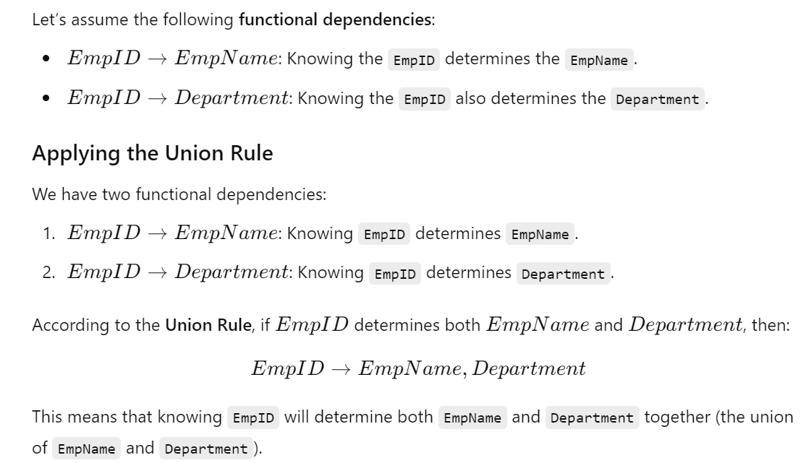
FUNCTIONAL DEPENDENCIES
Prepared By reshma Rachel cherish, Department of CSE (ai&ml) and CSE (Cyber security)
53

Slide 54
FUNCTIONAL DEPENDENCIES
Closure Set of Functional Dependencies
Union rule conclusion:
The Union Rule states that if α→β and α→γ, then α→β∪γ holds.
In simple terms, if a set of attributes α determines two other sets of attributes β and γ, then α will determine the union of β and γ as well.
The Union Rule is useful for deriving new functional dependencies in a database schema when you have multiple dependencies that involve the same set of attributes.
Prepared By reshma Rachel cherish, Department of CSE (ai&ml) and CSE (Cyber security)
54

Slide 55
FUNCTIONAL DEPENDENCIES
Despite the Armstrong’s rule being sound and complete, it is tiresome to use them directly for the computation of F+. To simplify this, we have additional 3 rules,
4. Decomposition rule – If α→βγ holds and α→β holds and α →γ holds.
if a set of attributes α determines the union of two sets β and γ, then α will also determine β and γ individually.
Example, consider the EMPLOYEE table
Prepared By reshma Rachel cherish, Department of CSE (ai&ml) and CSE (Cyber security)
55

Slide 56
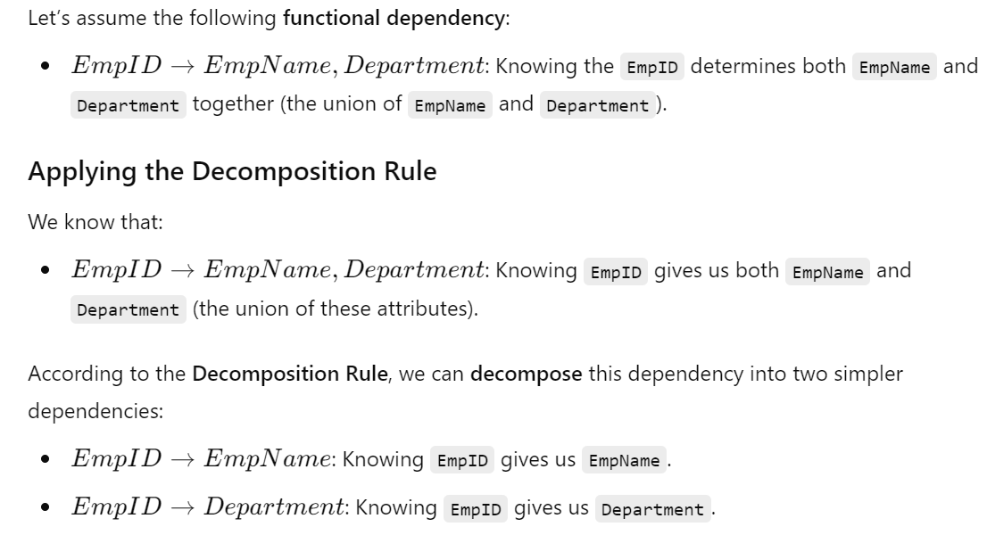
FUNCTIONAL DEPENDENCIES
Prepared By reshma Rachel cherish, Department of CSE (ai&ml) and CSE (Cyber security)
56

Slide 57
FUNCTIONAL DEPENDENCIES
Closure Set of Functional Dependencies
Decomposition rule conclusion:
The Decomposition Rule states that if α→β∪γ, then α→β and α→γ hold.
This rule allows you to break down a complex functional dependency (involving a union of attributes) into simpler functional dependencies.
In relational database design, this rule helps to simplify and normalize the functional dependencies, making the schema easier to analyze and maintain.
Prepared By reshma Rachel cherish, Department of CSE (ai&ml) and CSE (Cyber security)
57

Slide 58
FUNCTIONAL DEPENDENCIES
Despite the Armstrong’s rule being sound and complete, it is tiresome to use them directly for the computation of F+. To simplify this, we have additional 3 rules,
4. Pseudotransitivity rule – If α→β holds and γβ →δ holds, then αγ → δ holds.
In simpler terms, Pseudotransitivity says that if:
α determines β,
β∪γ determines δ,
Then, α∪γ determines δ.
This rule helps us to extend the functional dependencies from one set of attributes to a larger set, essentially "adding" new attributes to a functional dependency and still maintaining the determination relationship.
Prepared By reshma Rachel cherish, Department of CSE (ai&ml) and CSE (Cyber security)
58

Slide 59
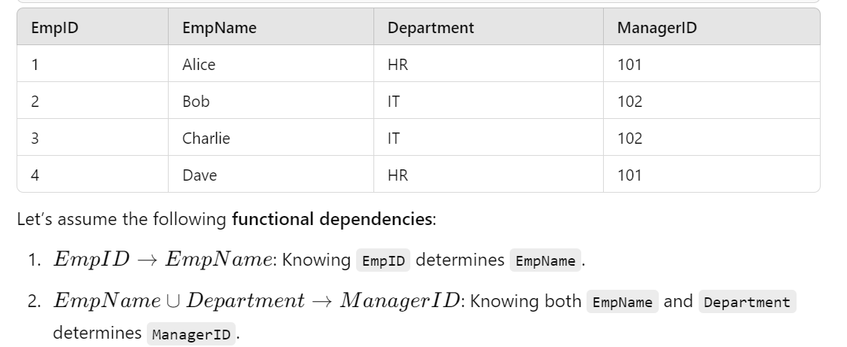
FUNCTIONAL DEPENDENCIES
Prepared By reshma Rachel cherish, Department of CSE (ai&ml) and CSE (Cyber security)
59

Slide 60
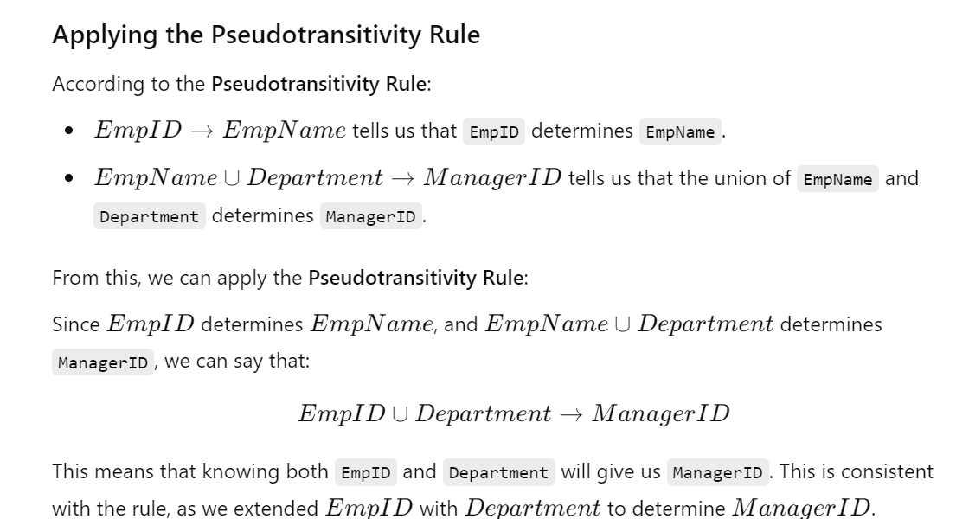
FUNCTIONAL DEPENDENCIES
Prepared By reshma Rachel cherish, Department of CSE (ai&ml) and CSE (Cyber security)
60

Slide 61
FUNCTIONAL DEPENDENCIES
Let us apply our rules to the example of schema R = (A, B, C, G, H, I) and the set F of functional dependencies {A → B, A → C, CG → H, CG → I , B → H}.
Several members of F+ here:
A → H. Since A → B and B → H hold, we apply the transitivity rule.
CG → HI. Since CG → H and CG → I, the union rule implies that CG → HI.
AG → I. Since A → C and CG → I, the pseudo-transitivity rule implies that AG → I holds.
Another way of finding that AG → I holds is as follows: We use the augmentation rule on A → C to infer AG → CG.
Applying the transitivity rule to this dependency and CG → I, we infer AG → I.
Prepared By reshma Rachel cherish, Department of CSE (ai&ml) and CSE (Cyber security)
61

Slide 62
FUNCTIONAL DEPENDENCIES
Closure of Attribute Sets – FDs w.r.to SUPER KEYS
An attribute B is functionally determined by α if α → B.
How to test whether a set α is a super key ?
Approach I:
To compute F+, take all functional dependencies with α as the left-hand side(i.e., α⁺) and take the union of the right-hand sides of all such dependencies
Example – Consider an Employee table and Functional Dependencies (F) defined as
EmpID → EmpName: EmpID determines EmpName
EmpID→Department: EmpID determines Department.
EmpID→ManagerID: EmpID determines ManagerID.
Now, let’s say we want to compute the closure of α={EmpID}, which {EmpID}⁺ ,
Prepared By reshma Rachel cherish, Department of CSE (ai&ml) and CSE (Cyber security)
62

Slide 63
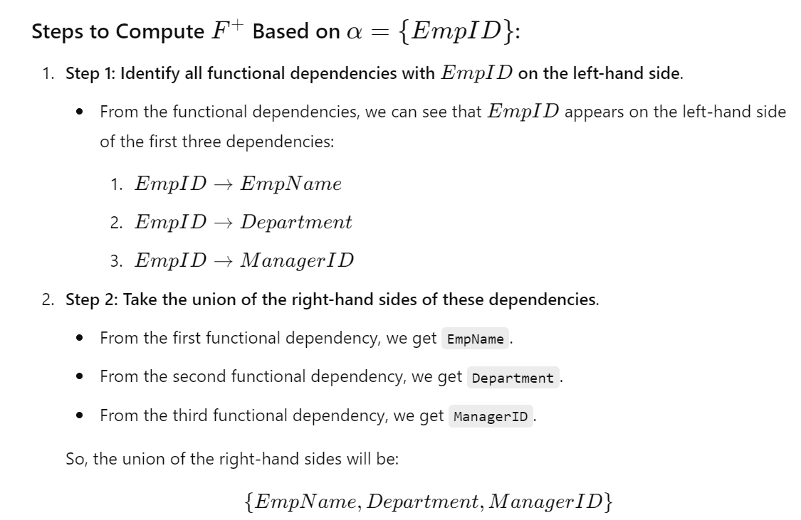
FUNCTIONAL DEPENDENCIES
Closure of Attribute Sets
Prepared By reshma Rachel cherish, Department of CSE (ai&ml) and CSE (Cyber security)
63

Slide 64
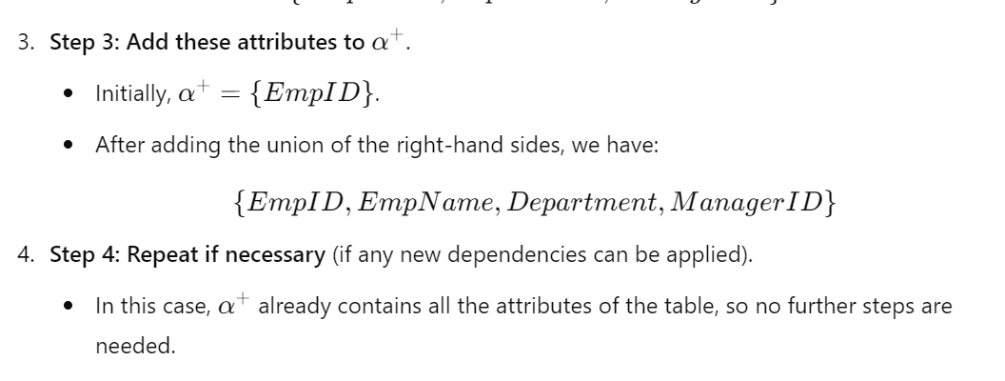
FUNCTIONAL DEPENDENCIES
Closure of Attribute Sets
So, after performing all the 4 steps we get,
This means that knowing EmpID determines all other attributes (EmpName, Department, and ManagerID). Therefore, EmpID is a superkey in this table because {EmpID}⁺ contains all the attributes in the relation.
Prepared By reshma Rachel cherish, Department of CSE (ai&ml) and CSE (Cyber security)
64

Slide 65
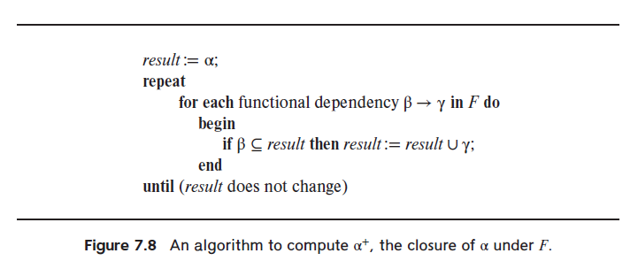
FUNCTIONAL DEPENDENCIES
Closure of Attribute Sets
Algorithm for computing the set of attributes functionally determined by α:
Let α be a set of attributes.
The set of all attributes functionally determined by α, under a set F of functional dependencies, the closure of α under F is denoted as α⁺
Inputs:
A set F of functional dependencies and the set α of attributes.
The output is stored in the variable result
Prepared By reshma Rachel cherish, Department of CSE (ai&ml) and CSE (Cyber security)
65

Slide 66
FUNCTIONAL DEPENDENCIES
Closure of Attribute Sets
Attribute Closure Algorithm for computing the set of attributes functionally determined by α:
Step 1: Initially, the result is set to α. This is because the closure of α will start with α itself, and we will gradually add more attributes to result based on the functional dependencies.
Step 2: This loop will continue until no new attributes can be added to result.
Step 3: Iterates through every functional dependency in the set F.
Step 4: For each functional dependency β→γ, check if the attributes in β are already present in the result. If β is a subset of result, this means we can apply the functional dependency and add the attributes in γ to result.
Prepared By reshma Rachel cherish, Department of CSE (ai&ml) and CSE (Cyber security)
66

Slide 67
FUNCTIONAL DEPENDENCIES
Closure of Attribute Sets
Uses of the Attribute Closure Algorithm :
To test if α is a superkey, we compute α+ and check if α+ contains all attributes in R.
We can check if a functional dependency α → β holds (or, in other words, is in F+), by checking if β ⊆ α+. That is, we compute α+ by using attribute closure, and then check if it contains β.
It gives us an alternative way to compute F+
Prepared By reshma Rachel cherish, Department of CSE (ai&ml) and CSE (Cyber security)
67

Slide 68
FUNCTIONAL DEPENDENCIES
Canonical Cover
Purpose: Suppose that we have a set of functional dependencies F on a relation schema. Whenever a user performs an update on the relation, the database system must ensure that the update does not violate any functional dependencies.
Meaning that all the functional dependencies in F are satisfied in the new database state. system must roll back the update if it violates any functional dependencies in the set F.
Benefit: Reduce the effort spent in checking for violations by testing a simplified set of functional dependencies that has the same closure as the given set
EXTRANEOUS ATTRIBUTES:
An attribute of a functional dependency is said to be extraneous if we can remove it without changing the closure of the set of functional dependencies.
Prepared By reshma Rachel cherish, Department of CSE (ai&ml) and CSE (Cyber security)
68

Slide 69
FUNCTIONAL DEPENDENCIES
Equivalence of sets of FDs
Two sets of FDs F and G are equivalent if:
- every FD in F can be inferred from G, and
- every FD in G can be inferred from F
Hence, F and G are equivalent if F + =G +
Definition: F covers G if every FD in G can be inferred from F (i.e., if G + subset-of F +)
F and G are equivalent if F covers G and G covers F
Note: Please check problems on finding if two sets of FDs are equivalent or not, given 2 sets of FDs.
Prepared By reshma Rachel cherish, Department of CSE (ai&ml) and CSE (Cyber security)
69

Slide 70
FUNCTIONAL DEPENDENCIES
Canonical Cover
EXTRANEOUS ATTRIBUTES:
The formal definition of extraneous attributes is as follows:
Consider a set F of functional dependencies and the functional dependency α → β in F.
Removal from the left side: Attribute A is extraneous in α if A ∈ α and F logically implies (F − {α → β}) ∪ {(α − A) → β}.
Removal from the right side: Attribute A is extraneous in β if A ∈ βand the set of functional dependencies (F − {α → β}) ∪ {α → (β − A)} logically implies F.
Prepared By reshma Rachel cherish, Department of CSE (ai&ml) and CSE (Cyber security)
70

Slide 71
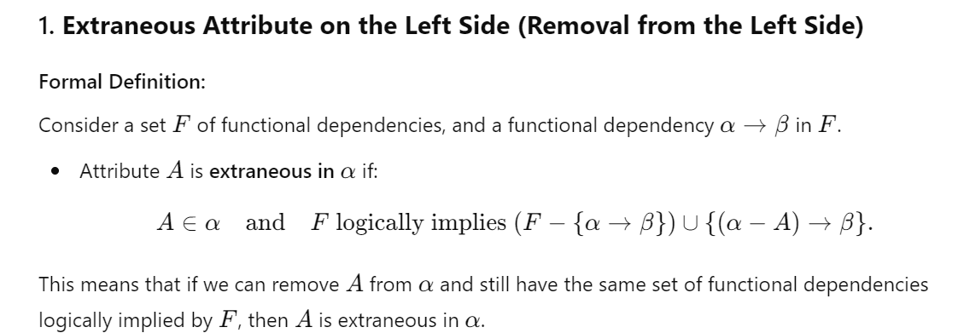
FUNCTIONAL DEPENDENCIES
Canonical Cover
EXTRANEOUS ATTRIBUTES:
Prepared By reshma Rachel cherish, Department of CSE (ai&ml) and CSE (Cyber security)
71

Slide 72
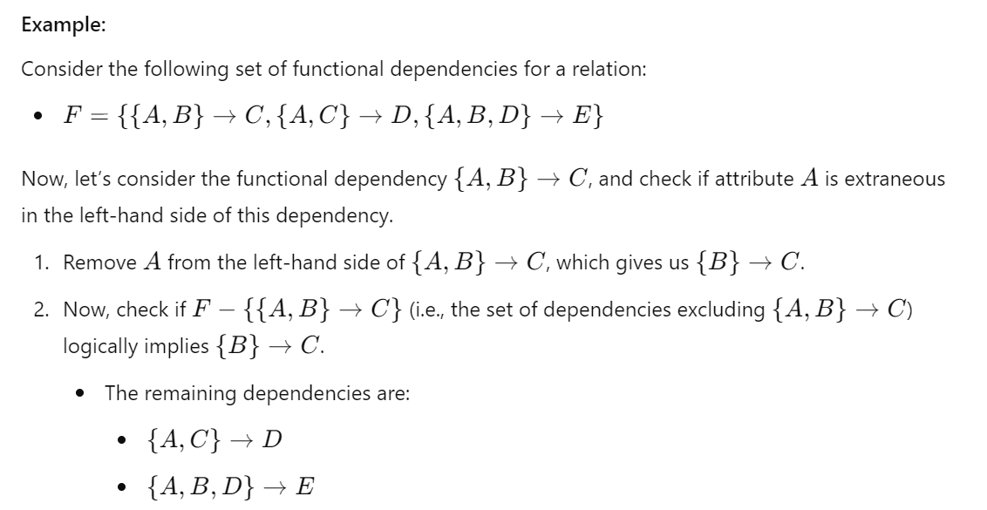
FUNCTIONAL DEPENDENCIES
Canonical Cover
EXTRANEOUS ATTRIBUTES:
Prepared By reshma Rachel cherish, Department of CSE (ai&ml) and CSE (Cyber security)
72

Slide 73
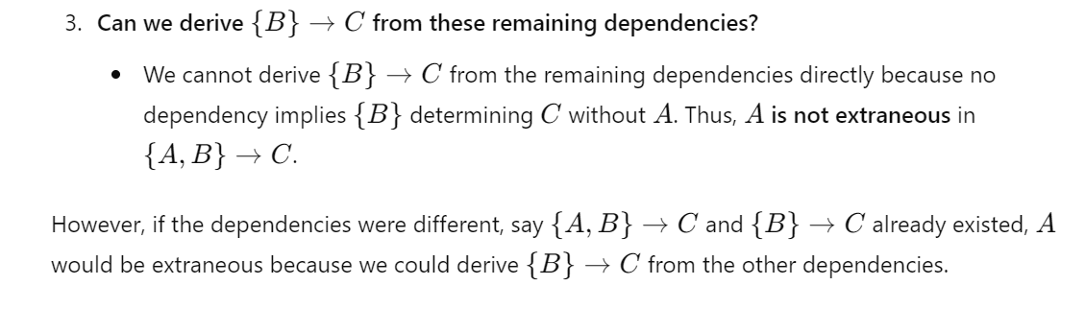
FUNCTIONAL DEPENDENCIES
Canonical Cover
EXTRANEOUS ATTRIBUTES:
Prepared By reshma Rachel cherish, Department of CSE (ai&ml) and CSE (Cyber security)
73

Slide 74
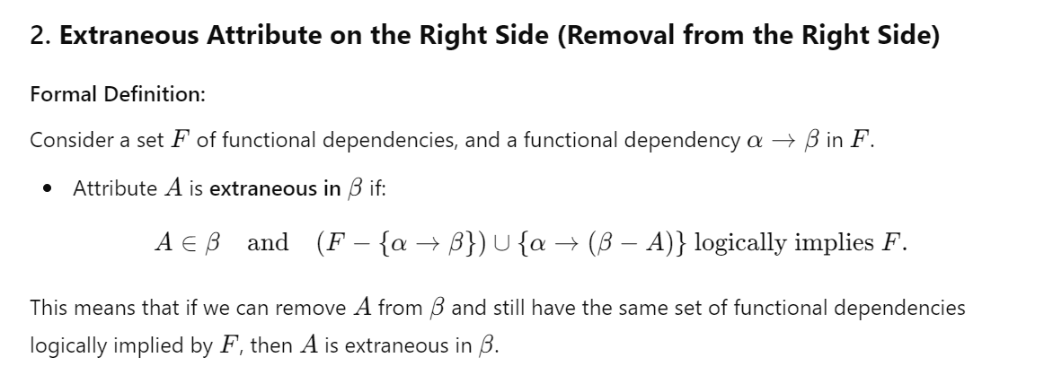
FUNCTIONAL DEPENDENCIES
Canonical Cover
EXTRANEOUS ATTRIBUTES:
Prepared By reshma Rachel cherish, Department of CSE (ai&ml) and CSE (Cyber security)
74

Slide 75
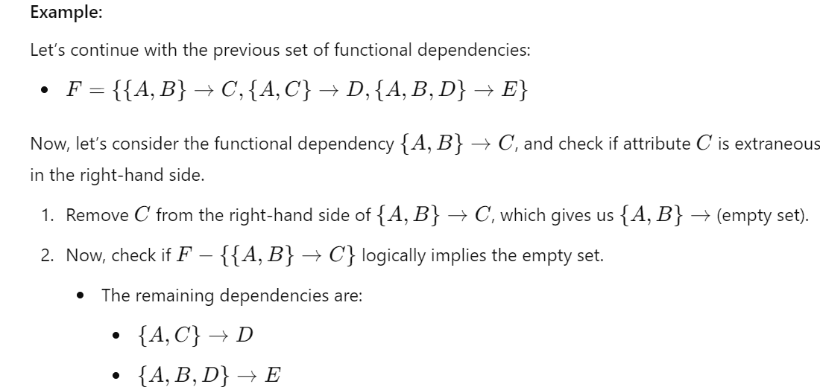
FUNCTIONAL DEPENDENCIES
Canonical Cover
EXTRANEOUS ATTRIBUTES:
Prepared By reshma Rachel cherish, Department of CSE (ai&ml) and CSE (Cyber security)
75

Slide 76
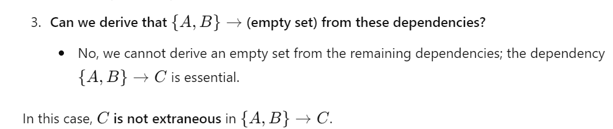
FUNCTIONAL DEPENDENCIES
Canonical Cover
EXTRANEOUS ATTRIBUTES:
Removing extraneous attributes helps simplify functional dependencies and is essential for database normalization, such as when computing candidate keys or simplifying normal forms.
Prepared By reshma Rachel cherish, Department of CSE (ai&ml) and CSE (Cyber security)
76

Slide 77
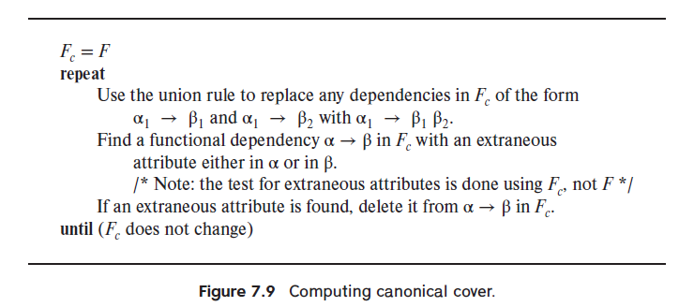
FUNCTIONAL DEPENDENCIES
Canonical Cover - construct a simplified set of functional dependencies equivalent to a given set of functional dependencies.
A canonical cover Fc for F is a set of dependencies such that F logically implies all dependencies in Fc, and Fc logically implies all dependencies in F.
Fc must have the following properties:
No functional dependency in Fc contains an extraneous attribute.
Each left side of a functional dependency in Fc is unique. That is, there are no two dependencies α1 → β1 and α2 → β2 in Fc such that α1 = α2.
Prepared By reshma Rachel cherish, Department of CSE (ai&ml) and CSE (Cyber security)
77

Slide 78
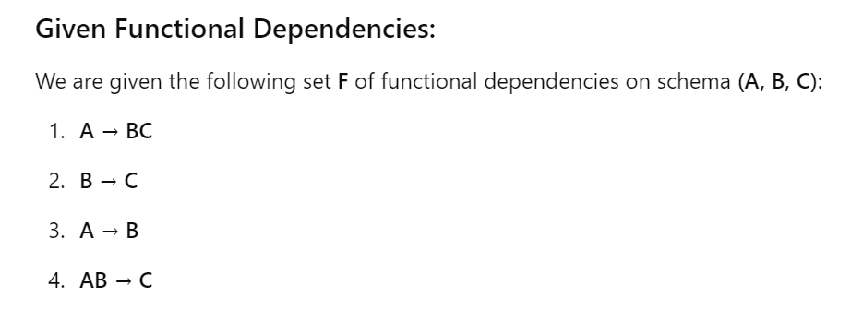
FUNCTIONAL DEPENDENCIES
Example
The steps of computing the canonical cover (Fc) for the given set of functional dependencies F will be shown below:
Prepared By reshma Rachel cherish, Department of CSE (ai&ml) and CSE (Cyber security)
78

Slide 79
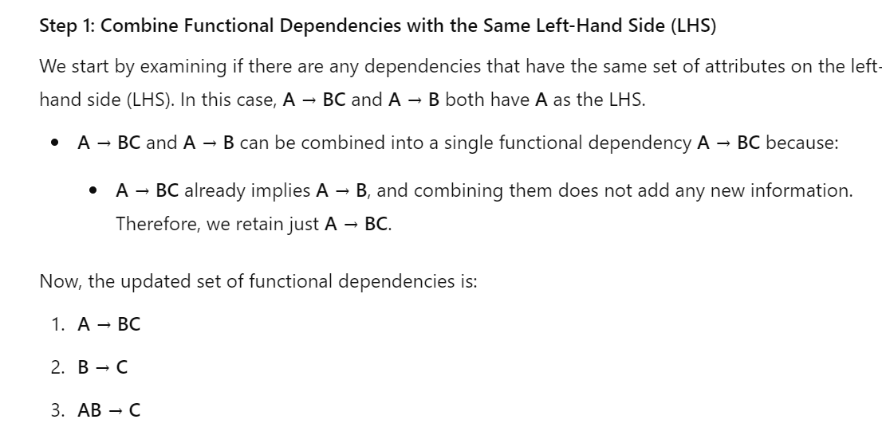
FUNCTIONAL DEPENDENCIES
Example
Prepared By reshma Rachel cherish, Department of CSE (ai&ml) and CSE (Cyber security)
79

Slide 80
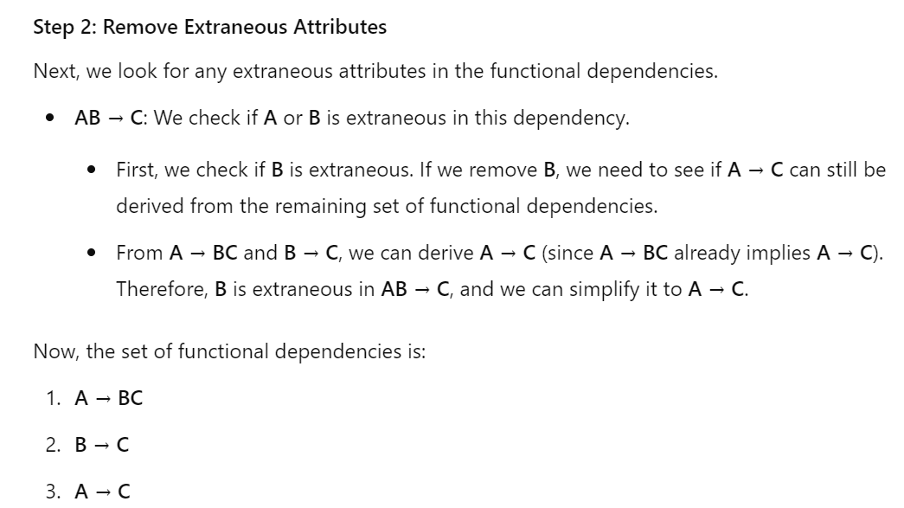
FUNCTIONAL DEPENDENCIES
Example
Prepared By reshma Rachel cherish, Department of CSE (ai&ml) and CSE (Cyber security)
80

Slide 81
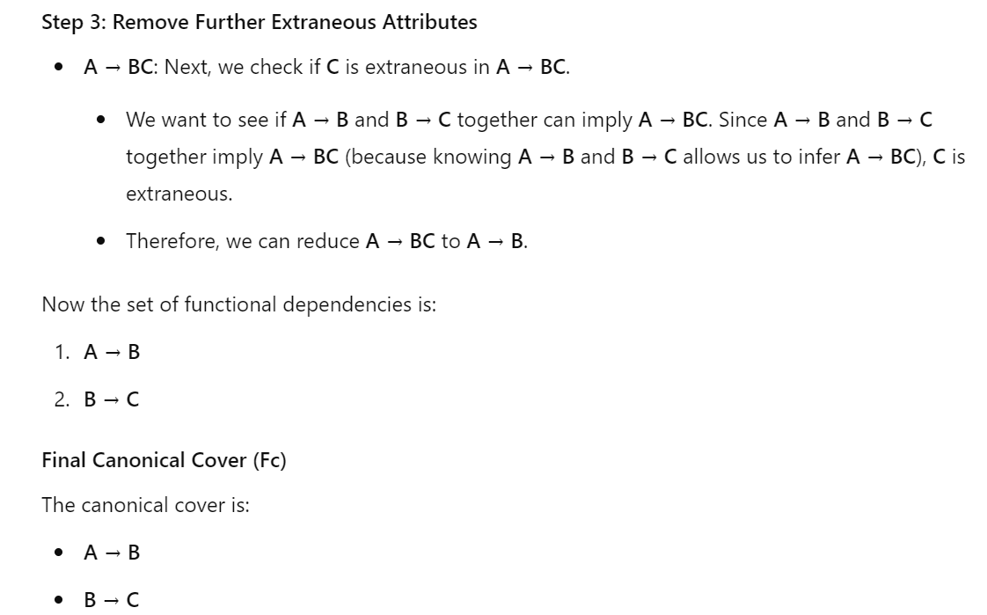
FUNCTIONAL DEPENDENCIES
Example
Prepared By reshma Rachel cherish, Department of CSE (ai&ml) and CSE (Cyber security)
81

Slide 82
FUNCTIONAL DEPENDENCIES
Dependency Preservation:
This is an additional property to ensure a good relational design.
Let F be a set of functional dependencies on a schema R.
Let R1, R2,…, Rn be a decomposition of R
The restriction of F to Ri is the set Fi of all functional dependencies in F+ that include only attributes of Ri.
Since all functional dependencies in a restriction
involve attributes of only one relation schema, it is possible to test such a dependency for satisfaction by checking only one relation.
Prepared By reshma Rachel cherish, Department of CSE (ai&ml) and CSE (Cyber security)
82

Slide 83
NORMALIZATION CONCEPTS
NORMAL FORMS BASED ON PRIMARY KEYS
Normalization of Relations
Practical Use of Normal Forms
Definitions of Keys and Attributes Participating in Keys
First Normal Form
Second Normal Form
Third Normal Form
Normalization: The process of decomposing unsatisfactory "bad" relations by breaking up their attributes into smaller relations
Normal Form (NF): Condition using keys and FDs of a relation to certify whether a relation schema is in a particular normal form.
How keys and FDs are used to determine the type of normal form (NF)?
Prepared By reshma Rachel cherish, Department of CSE (ai&ml) and CSE (Cyber security)
83

Slide 84
NORMALIZATION CONCEPTS
How keys and FDs are used to determine the type of normal form (NF)?
Keys | Functional dependant | Multi-valued Dependencies | Type of NF
Based on Keys of a relation schema | Based on FD of a relation schema | - | 2NF,3NF,BCNF
Based on Keys of a relation schema | - | Based on Multivalued dependencies | 4NF
Prepared By reshma Rachel cherish, Department of CSE (ai&ml) and CSE (Cyber security)
84

Slide 85
NORMALIZATION CONCEPTS
Normalization is carried out in practice so that the resulting designs are of high quality and meet the desirable properties.
The practical utility of these normal forms becomes questionable when the constraints on which they are based are hard to understand or to detect.
The database designers need not normalize to the highest possible normal form. (usually up to 3NF, BCNF or 4NF)
Denormalization: the process of storing the join of higher normal form relations as a base relation—which is in a lower normal form
Prepared By reshma Rachel cherish, Department of CSE (ai&ml) and CSE (Cyber security)
85

Slide 86
NORMALIZATION CONCEPTS
ATOMIC DOMAINS AND FIRST NORMAL (1NF) FORMS:
Purpose: The E-R model allows entity sets and relationship sets to have attributes that have some degree of substructure. Specifically, it allows multivalued attributes such as phone_number; and composite attributes (such as an attribute address with component attributes street, city, and state
So, when we design tables, each of these type of attributes gets translated into the following from an E-R diagram.
Composite Attributes - each component be an attribute in its own right.
Multi-valued Attributes - create one tuple for each item in a multivalued set.
Hence in a relational model, a domain is atomic if elements of the domain are considered to be indivisible units.
A relation schema R is in first normal form (1NF) if the domains of all attributes of R are atomic.
Prepared By reshma Rachel cherish, Department of CSE (ai&ml) and CSE (Cyber security)
86

Slide 87
NORMALIZATION CONCEPTS
ATOMIC DOMAINS AND FIRST NORMAL FORMS:
Examples –
A set of names is an example of a non-atomic value.
Integers are assumed to be atomic.
So 1NF disallows composite attributes, multivalued attributes, and nested relations; attributes whose values for an individual tuple are non-atomic.
Prepared By reshma Rachel cherish, Department of CSE (ai&ml) and CSE (Cyber security)
87

Slide 88
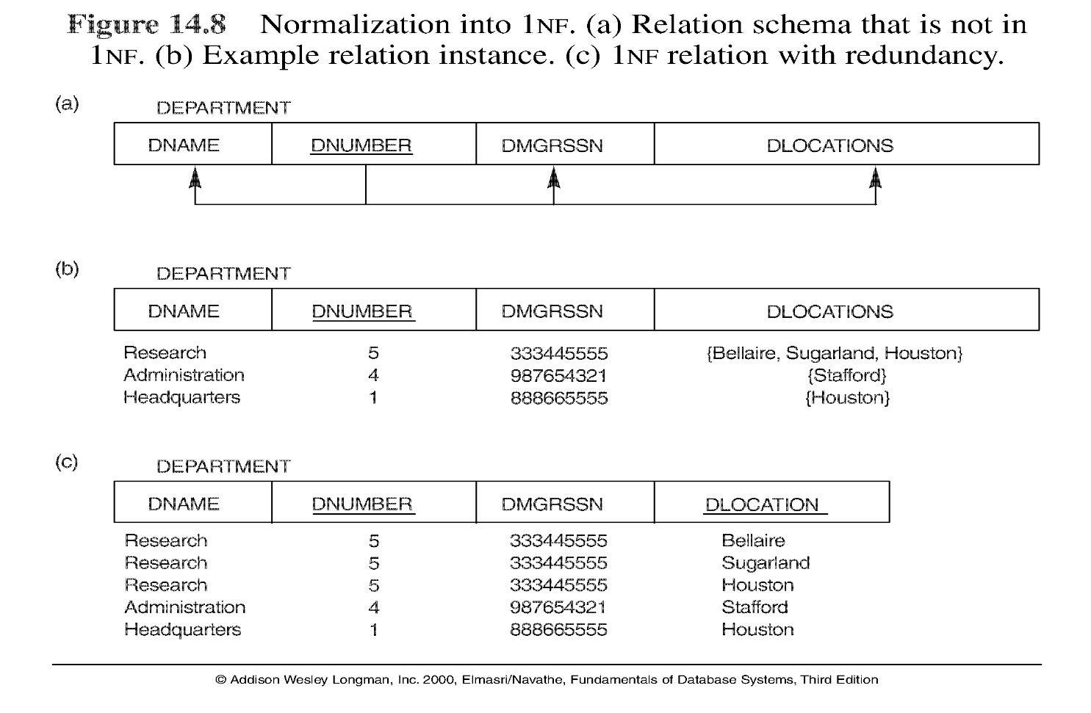
NORMALIZATION CONCEPTS
Prepared By reshma Rachel cherish, Department of CSE (ai&ml) and CSE (Cyber security)
88

Slide 89
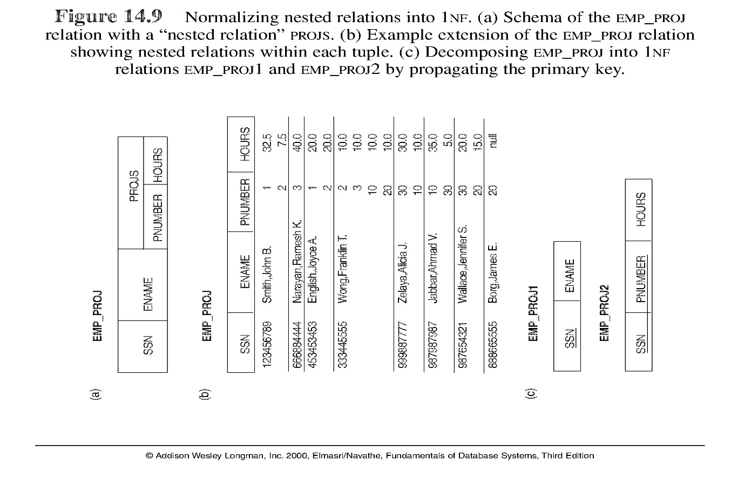
NORMALIZATION CONCEPTS
Normalization nested relations into 1NF
Prepared By reshma Rachel cherish, Department of CSE (ai&ml) and CSE (Cyber security)
89

Slide 90
NORMALIZATION CONCEPTS
SECOND NORMAL (2NF) FORM:
Purpose: 2NF (Second Normal Form) is a level of database normalization designed to reduce redundancy and ensure that the data is logically stored in a way that avoids certain types of data anomalies, specifically partial dependency anomalies.
A relation (or table) is in 2NF if it satisfies the following two conditions:
It is in 1NF (First Normal Form): This means that the table has only atomic (indivisible) values, each column contains only one value per record, and all entries in a column are of the same type.
No partial dependency: There should be no partial dependency in the table. A partial dependency occurs when a non-prime attribute (i.e., an attribute that is not part of a candidate key) depends on only part of a composite primary key (a primary key made up of multiple attributes), rather than on the whole primary key.
Prepared By reshma Rachel cherish, Department of CSE (ai&ml) and CSE (Cyber security)
90

Slide 91
NORMALIZATION CONCEPTS
SECOND NORMAL (2NF) FORM:
Uses the concepts of FDs, primary key.
Definitions:
Prime attribute - attribute that is member of the primary key K. i.e., an attribute is considered a prime attribute if it is part of the primary key (i.e., any attribute that is included in the set of attributes that form the primary key).
Full functional dependency - Y→Z means that all attributes in Y (the determinant) are necessary to determine Z. If we remove any attribute from Y, the functional dependency no longer holds. In other words, there should be no partial dependencies where a subset of the determinant can still uniquely determine the dependent attributes.
Prepared By reshma Rachel cherish, Department of CSE (ai&ml) and CSE (Cyber security)
91

Slide 92


NORMALIZATION CONCEPTS
SECOND NORMAL (2NF) FORM:
Prepared By reshma Rachel cherish, Department of CSE (ai&ml) and CSE (Cyber security)
92

Slide 93
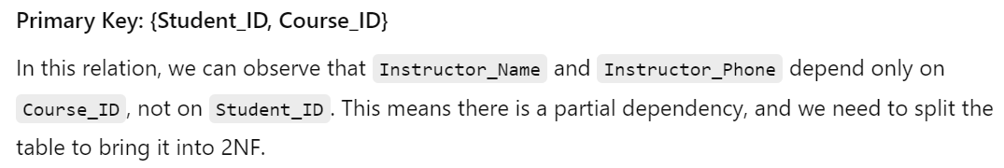
NORMALIZATION CONCEPTS
SECOND NORMAL (2NF) FORM:
Prepared By reshma Rachel cherish, Department of CSE (ai&ml) and CSE (Cyber security)
93

Slide 94


NORMALIZATION CONCEPTS
SECOND NORMAL (2NF) FORM:
Prepared By reshma Rachel cherish, Department of CSE (ai&ml) and CSE (Cyber security)
94

Slide 95
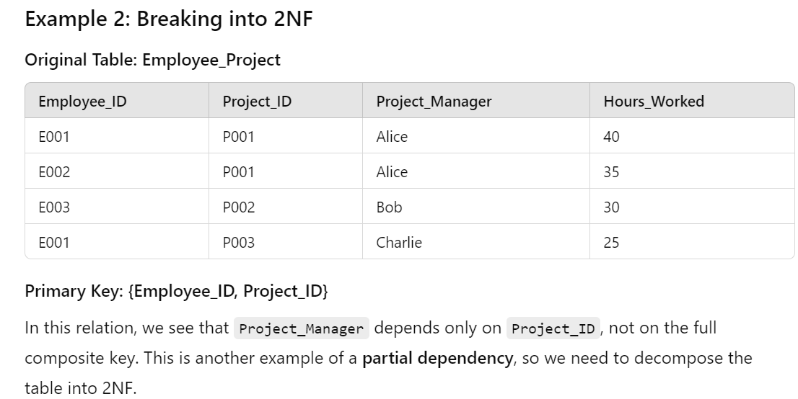
NORMALIZATION CONCEPTS
SECOND NORMAL (2NF) FORM:
Prepared By reshma Rachel cherish, Department of CSE (ai&ml) and CSE (Cyber security)
95

Slide 96
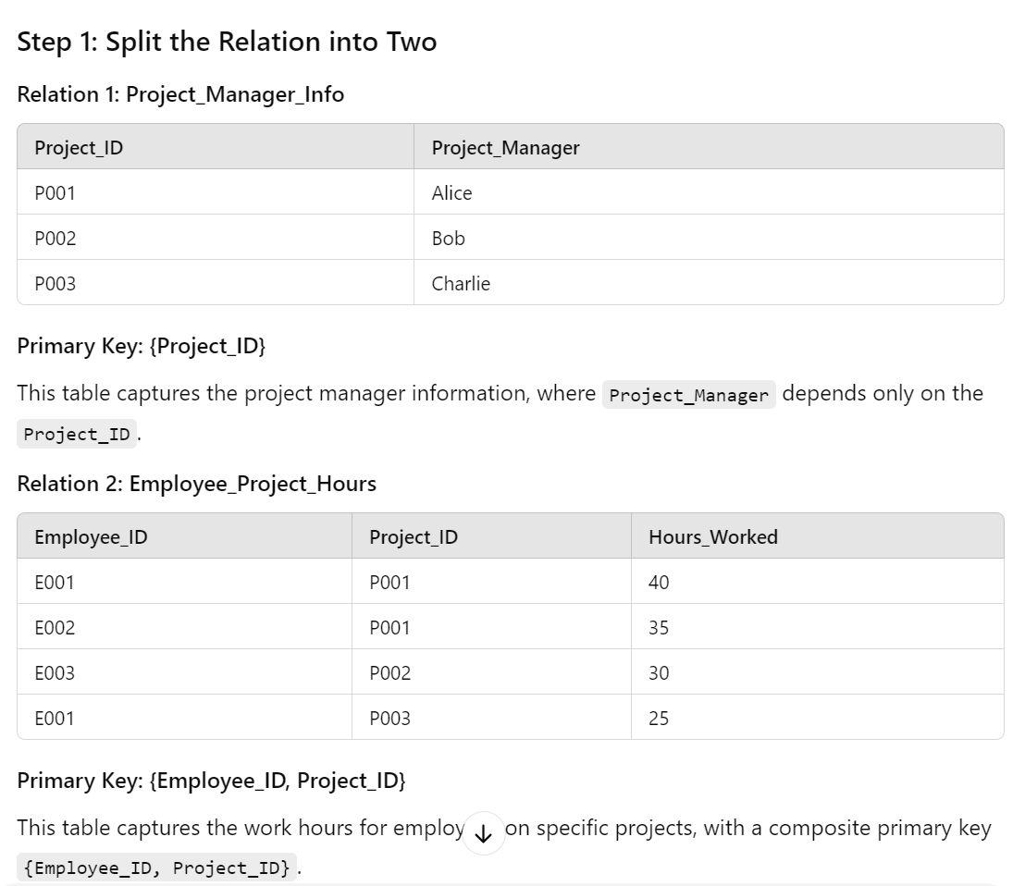
NORMALIZATION CONCEPTS
SECOND NORMAL (2NF) FORM:
Prepared By reshma Rachel cherish, Department of CSE (ai&ml) and CSE (Cyber security)
96

Slide 97


NORMALIZATION CONCEPTS
SECOND NORMAL (2NF) FORM:
Prepared By reshma Rachel cherish, Department of CSE (ai&ml) and CSE (Cyber security)
97

Slide 98




NORMALIZATION CONCEPTS
SECOND NORMAL (2NF) FORM:
Prepared By reshma Rachel cherish, Department of CSE (ai&ml) and CSE (Cyber security)
98

Slide 99
NORMALIZATION CONCEPTS
Concluding SECOND NORMAL (2NF) FORM:
A relation schema R is in second normal form (2NF) if every non-prime attribute A in R is fully functionally dependent on the primary key.
R can be decomposed into 2NF relations via the process of 2NF normalization.
Prepared By reshma Rachel cherish, Department of CSE (ai&ml) and CSE (Cyber security)
99

Slide 100
NORMALIZATION CONCEPTS
THIRD NORMAL (3NF) FORM:
Purpose: The primary motivation for going from 2NF (Second Normal Form) to 3NF (Third Normal Form) is to eliminate transitive dependencies and further reduce redundancy in the database.
A relation schema R is in third normal form (3NF) if it is in 2NF and no non-prime attribute A in R is transitively dependent on the primary key
R can be decomposed into 3NF relations via the process of 3NF normalization
Definition:
A relation schema R is in third normal form with respect to a set F of functional
dependencies if, for all functional dependencies in F+ of the form α → β, where α ⊆ R
and β ⊆ R, at least one of the following holds:
α → β is a trivial functional dependency.
α is a superkey for R.
Each attribute A in β − α is contained in a candidate key for R.
Prepared By reshma Rachel cherish, Department of CSE (ai&ml) and CSE (Cyber security)
100

Slide 101
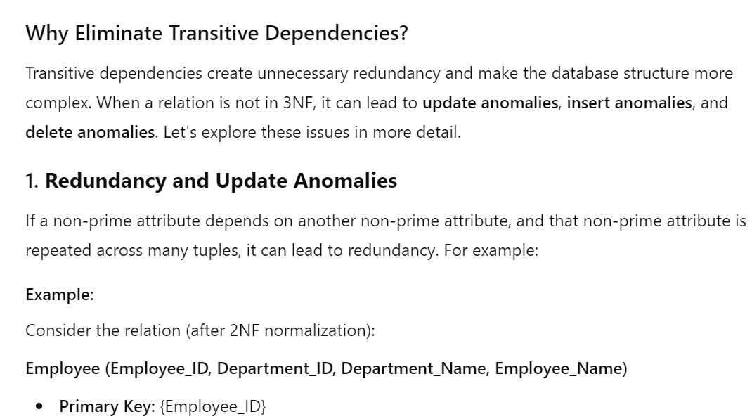
NORMALIZATION CONCEPTS
THIRD NORMAL (3NF) FORM:
Transitive Dependency: A transitive dependency occurs when a non-prime attribute depends on another non-prime attribute via a third attribute (i.e., A→B and B→C imply A→C).
Prepared By reshma Rachel cherish, Department of CSE (ai&ml) and CSE (Cyber security)
101

Slide 102
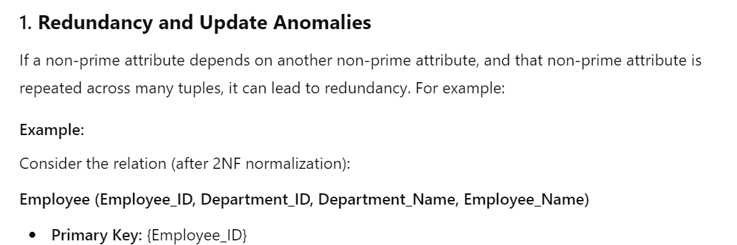
NORMALIZATION CONCEPTS
THIRD NORMAL (3NF) FORM:
FDs - Employee_ID → {Department_ID, Department_Name, Employee_Name}
Department_ID → Department_Name
Problem : If we need to update the name of a department, we would need to update it in every row that references that department. If we forget to update one or more rows, the database will contain inconsistent data.
Prepared By reshma Rachel cherish, Department of CSE (ai&ml) and CSE (Cyber security)
102

Slide 103

NORMALIZATION CONCEPTS
THIRD NORMAL (3NF) FORM:
Prepared By reshma Rachel cherish, Department of CSE (ai&ml) and CSE (Cyber security)
103

Slide 104

NORMALIZATION CONCEPTS
THIRD NORMAL (3NF) FORM:
Functional Dependencies: Employee_ID → {Department_ID, Department_Name, Employee_Name}
Department_ID → Department_Name
So there is a transitive dependency i.e., Employee_ID → Department_Name
This violates 3NF.
Prepared By reshma Rachel cherish, Department of CSE (ai&ml) and CSE (Cyber security)
104

Slide 105


NORMALIZATION CONCEPTS
THIRD NORMAL (3NF) FORM:
Prepared By reshma Rachel cherish, Department of CSE (ai&ml) and CSE (Cyber security)
105

Slide 106
NORMALIZATION CONCEPTS
BOYCE CODD NORMAL (BCNF) FORM:
BCNF is a stricter version of 3NF.
Definition: A relation schema R is in BCNF with respect to a set F of functional dependencies if, for all functional dependencies in F+ of the form α → β, where α ⊆ R and β ⊆ R, at least one of the following holds:
α → β is a trivial functional dependency (i.e., β ⊆ α).
α is a superkey for schema R.
How to test if a relation is in BCNF?
In other words, A relation is in BCNF if it satisfies the following conditions:
It is in 3NF.
For every non-trivial functional dependency X→Y, X is a superkey (i.e., X must be a superkey, or it must uniquely identify a row in the table).
A trivial functional dependency is a type of functional dependency where the right-hand side (RHS) of the dependency is always contained in the left-hand side (LHS) (or) a functional dependency is trivial if the set of attributes on the right-hand side is a subset of the set of attributes on the left-hand side.
A functional dependency X→Y is trivial if:
Y is a subset of X. This means that all the attributes in Y are already part of the set X, so the dependency is obvious or self-evident or implied.
Prepared By reshma Rachel cherish, Department of CSE (ai&ml) and CSE (Cyber security)
106

Slide 107

NORMALIZATION CONCEPTS
BOYCE CODD NORMAL (BCNF) FORM:
FDs: {Student_ID, Course_ID} → {Instructor_Name, Instructor_Phone}
{Course_ID} → {Instructor_Name, Instructor_Phone}
Composite Primary key: {Student_I​D,Course_ID} as each student is enrolled in multiple courses, and each combination of Student_ID and Course_ID is unique.
Prepared By reshma Rachel cherish, Department of CSE (ai&ml) and CSE (Cyber security)
107

Slide 108
NORMALIZATION CONCEPTS
BOYCE CODD NORMAL (BCNF) FORM:
Now, why is the above relation told not to be in BCNF?
A relation is in BCNF if, for every non-trivial functional dependency X→Y, X is a superkey (i.e., it uniquely identifies a tuple in the relation).
In the current relation, we have a functional dependency:
{Course_ID} → {Instructor_Name, Instructor_Phone}
Here, {Course_ID} is not a superkey because it does not uniquely identify a row in the relation (Multiple students can be enrolled in the same course, so {Course_ID} does not determine a unique tuple by itself).
Since, {Course_ID} is not a superkey, this violates the BCNF condition.
Prepared By reshma Rachel cherish, Department of CSE (ai&ml) and CSE (Cyber security)
108

Slide 109

NORMALIZATION CONCEPTS
BOYCE CODD NORMAL (BCNF) FORM:
Decompose the Relation to Achieve BCNF:
To convert this relation into BCNF, we need to remove the dependency where a non-superkey (in this case, {Course_ID} determines other attributes. We can do this by decomposing the relation.
Relation 1: Course_Instructor where the FD will be Course_ID → {Instructor_Name, Instructor_Phone}
Hence in this relation (Relation 1), Course_ID is the SuperKey and so this table satisfies BCNF.
Prepared By reshma Rachel cherish, Department of CSE (ai&ml) and CSE (Cyber security)
109

Slide 110

NORMALIZATION CONCEPTS
BOYCE CODD NORMAL (BCNF) FORM:
Decompose the Relation to Achieve BCNF:
Relation 2: Student_Course where the FD will be Course_ID → {Instructor_Name, Instructor_Phone}
There are no non-trivial functional dependencies that violate the BCNF condition. The primary key {Student_I​D, Course_I​D} uniquely determines the tuple, so this relation is also in BCNF.
Prepared By reshma Rachel cherish, Department of CSE (ai&ml) and CSE (Cyber security)
110

Slide 111
NORMALIZATION CONCEPTS
BOYCE CODD NORMAL (BCNF) FORM:
Verifying BCNF Compliance:
Relation 1: Course_Instructor where the FD will be Course_ID → {Instructor_Name, Instructor_Phone}
holds, and {Course_ID} is the superkey. Hence, the relation is in BCNF.
Relation 2: Student_Course
There are no non-trivial functional dependencies that violate the BCNF condition. The primary key {Student_ID, Course_ID} uniquely determines the tuple, so this relation is also in BCNF.
Prepared By reshma Rachel cherish, Department of CSE (ai&ml) and CSE (Cyber security)
111

Slide 112
PROPERTIES OF RELATIONAL DECOMPOSITIONS
Relation Decomposition and Insufficiency of Normal Forms :
Universal Relation Schema: a relation schema R={A1, A2, …, An} that includes all the attributes of the database.
Universal Relation Assumption: Every attribute name is unique.
Decomposition: The process of decomposing the universal relation schema R into a set of relation schemas D = {R1,R2, …, Rm} that will become the relational database schema by using the functional dependencies.
Attribute preservation condition: Each attribute in R will appear in at least one relation schema Ri in the decomposition so that no attributes are “lost”.
Another goal of decomposition is to have each individual relation Ri in the decomposition D be in BCNF or 3NF.
Additional properties of decomposition are it is needed to prevent from generating spurious tuples.
Prepared By reshma Rachel cherish, Department of CSE (ai&ml) and CSE (Cyber security)
112

Slide 113
PROPERTIES OF RELATIONAL DECOMPOSITIONS
Dependency Preservation Property of a Decomposition :
Definition: Given a set of dependencies F on R, the projection of F on R_{i}, denoted by p_{Ri}(F) where R_{i} is a subset of R, is the set of dependencies X  Y in F⁺ such that the attributes in X υ Y are all contained in R_{i}.
Hence, the projection of F on each relation schema Ri in the decomposition D is the set of functional dependencies in F+, the closure of F, such that all their left- and right-hand-side attributes are in Ri.
Dependency Preservation Property:
A decomposition D = {R1, R2, ..., Rm} of R is dependency-preserving with respect to F if the union of the projections of F on each Ri in D is equivalent to F; that is, ((R1(F)) υ . . . υ (Rm(F)))+ = F+
Let’s see this property with an example.
Prepared By reshma Rachel cherish, Department of CSE (ai&ml) and CSE (Cyber security)
113

Slide 114

PROPERTIES OF RELATIONAL DECOMPOSITIONS
Dependency Preservation Property of a Decomposition :
Prepared By reshma Rachel cherish, Department of CSE (ai&ml) and CSE (Cyber security)
114

Slide 115

PROPERTIES OF RELATIONAL DECOMPOSITIONS
Dependency Preservation Property of a Decomposition :
Claim 1: It is always possible to find a dependency-preserving decomposition D with respect to F such that each relation Ri in D is in 3NF.
Prepared By reshma Rachel cherish, Department of CSE (ai&ml) and CSE (Cyber security)
115

Slide 116

PROPERTIES OF RELATIONAL DECOMPOSITIONS
Lossless (Non-additive) Join Property of a Decomposition:
Definition:
Lossless Join Property: a decomposition D = {R1, R2, ..., Rm} of R has the lossless (nonadditive) join property with respect to the set of dependencies F on R if, for every relation state r of R that satisfies F, the following holds, where * is the natural join of all the relations in D:
Note: The word loss in lossless refers to loss of information, not to loss of tuples. In fact, for “loss of information” a better term is “addition of spurious information”
Algorithm: Testing for Lossless Join Property
Input: A universal relation R, a decomposition D = {R1, R2, ..., Rm} of R, and a set F of functional dependencies.
Prepared By reshma Rachel cherish, Department of CSE (ai&ml) and CSE (Cyber security)
116

Slide 117
PROPERTIES OF RELATIONAL DECOMPOSITIONS
Lossless (Non-additive) Join Property of a Decomposition:
Algorithm: Testing for Lossless Join Property
Create an initial matrix S with one row i for each relation Ri in D, and one column j for each attribute Aj in R.
Set S(i,j):=b_{ij} for all matrix entries. (* each b_{ij} is a distinct symbol associated with indices (i,j) *).
For each row i representing relation schema Ri
{for each column j representing attribute Aj
{if (relation Ri includes attribute Aj) then set S(i,j):= aj;};};
(* each aj is a distinct symbol associated with index (j) *)
Prepared By reshma Rachel cherish, Department of CSE (ai&ml) and CSE (Cyber security)
117

Slide 118
PROPERTIES OF RELATIONAL DECOMPOSITIONS
Lossless (Non-additive) Join Property of a Decomposition:
Algorithm: Testing for Lossless Join Property
Repeat the following loop until a complete loop execution results in no changes to S
{for each functional dependency X  Y in F
{for all rows in S which have the same symbols in the columns corresponding to attributes in X
{make the symbols in each column that correspond to an attribute in Y be the same in all these rows as follows: if any of the rows has an “a” symbol for the column, set the other rows to that same “a” symbol in the column. If no “a” symbol exists for the attribute in any of the rows, choose one of the “b” symbols that appear in one of the rows for the attribute and set the other rows to that same “b” symbol in the column ;};};};
If a row is made up entirely of “a” symbols, then the decomposition has the lossless join property; otherwise, it does not.
Prepared By reshma Rachel cherish, Department of CSE (ai&ml) and CSE (Cyber security)
118

Slide 119

PROPERTIES OF RELATIONAL DECOMPOSITIONS
Lossless (Non-additive) Join Property of a Decomposition:
Algorithm: Testing for Lossless Join Property
Example:
Prepared By reshma Rachel cherish, Department of CSE (ai&ml) and CSE (Cyber security)
119

Slide 120

PROPERTIES OF RELATIONAL DECOMPOSITIONS
Lossless (Non-additive) Join Property of a Decomposition:
Algorithm: Testing for Lossless Join Property
Example:
Prepared By reshma Rachel cherish, Department of CSE (ai&ml) and CSE (Cyber security)
120

Slide 121

PROPERTIES OF RELATIONAL DECOMPOSITIONS
Lossless (Non-additive) Join Property of a Decomposition:
Algorithm: Testing for Lossless Join Property
Example:
Prepared By reshma Rachel cherish, Department of CSE (ai&ml) and CSE (Cyber security)
121

Slide 122

PROPERTIES OF RELATIONAL DECOMPOSITIONS
Lossless (Non-additive) Join Property of a Decomposition:
Algorithm: Testing for Lossless Join Property
Example:
Prepared By reshma Rachel cherish, Department of CSE (ai&ml) and CSE (Cyber security)
122

Slide 123

PROPERTIES OF RELATIONAL DECOMPOSITIONS
Lossless (Non-additive) Join Property of a Decomposition:
Algorithm: Testing for Lossless Join Property
Example:
Prepared By reshma Rachel cherish, Department of CSE (ai&ml) and CSE (Cyber security)
123

Slide 124

PROPERTIES OF RELATIONAL DECOMPOSITIONS
Lossless (Non-additive) Join Property of a Decomposition:
Algorithm: Testing for Lossless Join Property
Example:
Prepared By reshma Rachel cherish, Department of CSE (ai&ml) and CSE (Cyber security)
124

Slide 125

PROPERTIES OF RELATIONAL DECOMPOSITIONS
Lossless (Non-additive) Join Property of a Decomposition:
Algorithm: Testing for Lossless Join Property
Example:
Prepared By reshma Rachel cherish, Department of CSE (ai&ml) and CSE (Cyber security)
125

Slide 126
PROPERTIES OF RELATIONAL DECOMPOSITIONS
Testing Binary Decompositions for Lossless Join Property:
Binary Decomposition : Decomposition of a relation R into two relations.
Property LJ1 (lossless join test for binary decompositions):
A decomposition D = {R1, R2} of R has the lossless join property wrt. a set of functional dependencies F on R if and only if either
The f.d. ((R1 ∩ R2)  (R1- R2)) is in F+, or
The f.d. ((R1 ∩ R2)  (R2 - R1)) is in F+
Successive Lossless Join Decomposition:
Claim 2 (Preservation of non-additivity in successive decompositions):
If a decomposition D = {R1, R2, ..., Rm} of R has the lossless (non-additive) join property with respect to a set of functional dependencies F on R, and if a decomposition Di = {Q1, Q2, ..., Qk} of Ri has the lossless (non-additive) join property with respect to the projection of F on Ri, then the decomposition D2 = {R1, R2, ..., Ri-1, Q1, Q2, ..., Qk, Ri+1, ..., Rm} of R has the non-additive join property with respect to F.
Prepared By reshma Rachel cherish, Department of CSE (ai&ml) and CSE (Cyber security)
126

Slide 127
ALGORITHMS FOR RELATIONAL DATABASE SCHEMA DESIGN
Relational Synthesis Algorithm:
Goal - Relational Synthesis into 3NF with Dependency Preservation.
Input - A universal relation R and a set of functional dependencies F on the attributes of R.
Algorithm Steps –
Find a minimal cover G for F.
For each left-hand-side X of a functional dependency that appears in G, create a relation schema in D with attributes {X υ {A1} υ {A2} ... υ {Ak}}, where X  A1, X  A2, ..., X  Ak are the only dependencies in G with X as left-hand-side (X is the key of this relation)
Place any remaining attributes (that have not been placed in any relation) in a single relation schema to ensure the attribute preservation property.
Claim – Every relation schema created by this algorithm is in 3NF.
Prepared By reshma Rachel cherish, Department of CSE (ai&ml) and CSE (Cyber security)
127

Slide 128

ALGORITHMS FOR RELATIONAL DATABASE SCHEMA DESIGN
Relational Synthesis Algorithm:
Example :
Prepared By reshma Rachel cherish, Department of CSE (ai&ml) and CSE (Cyber security)
128

Slide 129

ALGORITHMS FOR RELATIONAL DATABASE SCHEMA DESIGN
Relational Synthesis Algorithm:
Example :
Prepared By reshma Rachel cherish, Department of CSE (ai&ml) and CSE (Cyber security)
129

Slide 130

ALGORITHMS FOR RELATIONAL DATABASE SCHEMA DESIGN
Relational Synthesis Algorithm:
Example :
Prepared By reshma Rachel cherish, Department of CSE (ai&ml) and CSE (Cyber security)
130

Slide 131

ALGORITHMS FOR RELATIONAL DATABASE SCHEMA DESIGN
Relational Synthesis Algorithm:
Example :
Prepared By reshma Rachel cherish, Department of CSE (ai&ml) and CSE (Cyber security)
131

Slide 132

ALGORITHMS FOR RELATIONAL DATABASE SCHEMA DESIGN
Relational Synthesis Algorithm:
Example :
Prepared By reshma Rachel cherish, Department of CSE (ai&ml) and CSE (Cyber security)
132

Slide 133

ALGORITHMS FOR RELATIONAL DATABASE SCHEMA DESIGN
Relational Synthesis Algorithm:
Example :
Prepared By reshma Rachel cherish, Department of CSE (ai&ml) and CSE (Cyber security)
133

Slide 134

ALGORITHMS FOR RELATIONAL DATABASE SCHEMA DESIGN
Relational Synthesis Algorithm:
Example :
Prepared By reshma Rachel cherish, Department of CSE (ai&ml) and CSE (Cyber security)
134

Slide 135
ALGORITHMS FOR RELATIONAL DATABASE SCHEMA DESIGN
Relational Decomposition into BCNF with Lossless (non-additive) join property:
Goal – To achieve Boyce Codd Normal Form and preserve the lossless join property in relations
Input - A universal relation R and a set of functional dependencies F on the attributes of R.
Algorithm Steps –
Set D := {R};
While there is a relation schema Q in D that is not in BCNF
do {
choose a relation schema Q in D that is not in BCNF;
find a functional dependency X  Y in Q that violates BCNF;
replace Q in D by two relation schemas (Q - Y) and (X υ Y);
};
Assumption: No null values are allowed for the join attributes.
Prepared By reshma Rachel cherish, Department of CSE (ai&ml) and CSE (Cyber security)
135

Slide 136

ALGORITHMS FOR RELATIONAL DATABASE SCHEMA DESIGN
Relational Decomposition into BCNF with Lossless (non-additive) join property:
Example –
Prepared By reshma Rachel cherish, Department of CSE (ai&ml) and CSE (Cyber security)
136

Slide 137

ALGORITHMS FOR RELATIONAL DATABASE SCHEMA DESIGN
Relational Decomposition into BCNF with Lossless (non-additive) join property:
Example –
Prepared By reshma Rachel cherish, Department of CSE (ai&ml) and CSE (Cyber security)
137

Slide 138

ALGORITHMS FOR RELATIONAL DATABASE SCHEMA DESIGN
Relational Decomposition into BCNF with Lossless (non-additive) join property:
Example –
Prepared By reshma Rachel cherish, Department of CSE (ai&ml) and CSE (Cyber security)
138

Slide 139

ALGORITHMS FOR RELATIONAL DATABASE SCHEMA DESIGN
Relational Decomposition into BCNF with Lossless (non-additive) join property:
Example –
Prepared By reshma Rachel cherish, Department of CSE (ai&ml) and CSE (Cyber security)
139

Slide 140

ALGORITHMS FOR RELATIONAL DATABASE SCHEMA DESIGN
Relational Decomposition into BCNF with Lossless (non-additive) join property:
Example –
Prepared By reshma Rachel cherish, Department of CSE (ai&ml) and CSE (Cyber security)
140

Slide 141
ALGORITHMS FOR RELATIONAL DATABASE SCHEMA DESIGN
Relational Synthesis into 3NF with Dependency Preservation and Lossless (Non-Additive) Join Property
Goal – To achieve 3NF ; preserve the functional dependencies; and maintain the lossless join property
Input – A universal relation R and a set of functional dependencies F on the attributes of R.
Algorithm Steps -
Find a minimal cover G for F
For each left-hand-side X of a functional dependency that appears in G, create a relation schema in D with attributes {X υ {A1} υ {A2} ... υ {Ak}}, where X  A1, X  A2, ..., X –>Ak are the only dependencies in G with X as left-hand-side (X is the key of this relation).
If none of the relation schemas in D contains a key of R, then create one more relation schema in D that contains attributes that form a key of R.
Prepared By reshma Rachel cherish, Department of CSE (ai&ml) and CSE (Cyber security)
141

Slide 142
ALGORITHMS FOR RELATIONAL DATABASE SCHEMA DESIGN
Finding a Key K for R Given a set F of Functional Dependencies
Goal – to identify a candidate key (or keys) for the relation. A candidate key is a minimal set of attributes that can uniquely identify a tuple in the relation, considering the functional dependencies provided.
Input – A universal relation R and a set of functional dependencies F on the attributes of R.
Algorithm Steps –
Set K := R.
For each attribute A in K {
compute (K - A)+ with respect to F;
If (K - A)+ contains all the attributes in R,
then set K := K - {A}; }
Prepared By reshma Rachel cherish, Department of CSE (ai&ml) and CSE (Cyber security)
142

Slide 143

ALGORITHMS FOR RELATIONAL DATABASE SCHEMA DESIGN
Finding a Key K for R Given a set F of Functional Dependencies
Example –
Prepared By reshma Rachel cherish, Department of CSE (ai&ml) and CSE (Cyber security)
143

Slide 144

ALGORITHMS FOR RELATIONAL DATABASE SCHEMA DESIGN
Finding a Key K for R Given a set F of Functional Dependencies
Example –
Prepared By reshma Rachel cherish, Department of CSE (ai&ml) and CSE (Cyber security)
144

Slide 145

ALGORITHMS FOR RELATIONAL DATABASE SCHEMA DESIGN
Finding a Key K for R Given a set F of Functional Dependencies
Example –
Prepared By reshma Rachel cherish, Department of CSE (ai&ml) and CSE (Cyber security)
145

Slide 146
ALGORITHMS FOR RELATIONAL DATABASE SCHEMA DESIGN
Finding a Key K for R Given a set F of Functional Dependencies
Conclusion –
Compute the closure of different attribute sets to check which sets can determine all attributes in the relation.
Identify the minimal set of attributes that determine all attributes — these are the candidate keys.
If necessary, choose one candidate key as the primary key.
The goal is to find a minimal set of attributes (a candidate key) that can uniquely identify a tuple in the relation, ensuring the integrity and efficiency of the database schema.
Prepared By reshma Rachel cherish, Department of CSE (ai&ml) and CSE (Cyber security)
146

